Slide 1
Clime change and Health
Ricardo Izurieta

Slide 2
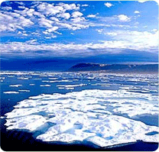
Introduction
Climate change is one the biggest global health treats of the new century
Billions of people will be at risk of the effects of climate change
Northern areas of Canada, Greenland and Siberia will be the most affected

Slide 3
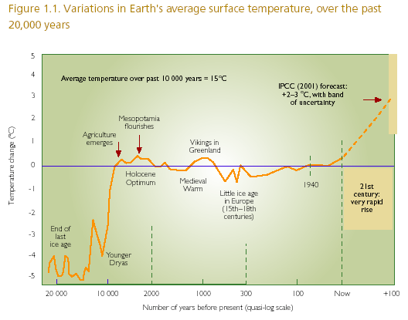
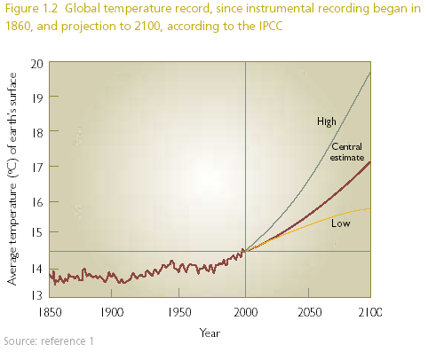
History of climate sciences and effect on health
In 1896 the Sweden scientist, Svante Arrhenius adverted about the effects of global warming caused by CO2 produced by human activity.
The observations were confirmed later by Thomas Chamberlin

Slide 4
The green house effect
When animals or plants die the carbon is retained in oceans or land
This is the way how plans and marine animals died 350 millions ago and formed fossil fuels such as: oil, coal, and natural gas.

Slide 5
The green house effect
One third of sun’s energy is reflected by the earth
The reminded is absorbed by lands and oceans
Atmospheric gases like: water vapor, CO₂, ozone, methane, and nitrous oxide can absorb sun’s energy and can be warmed by it.

Slide 6
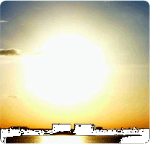
The green house effect
Industrial revolution by combustion of these fossil fuels, started to release carbon back into the atmosphere.

Slide 7
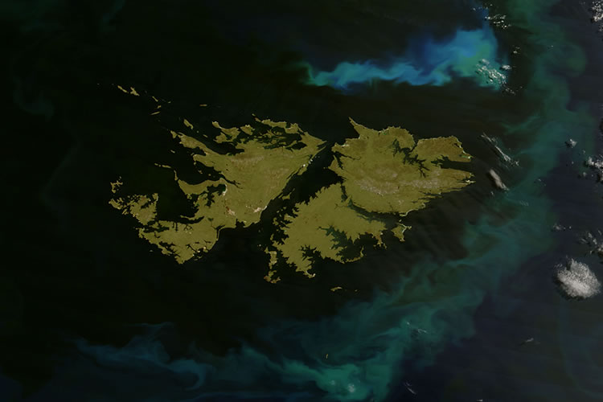
Impact on oceans and ground water
Higher concentration of salt and algae in oceans
Sal deposit in ground water
Low level of river tributaries
Algae blooms
Melting of the Greenland ice sheet can change salt concentrations in the ocean water

Slide 8
Impact on Coral bleaching
Coral bleaching is the damage of the zoozanthellae of the coral reefs area by sunlight because of increase in the temperature
This phenomenon can be catastrophic especially for the tropical marine ecosystems

Slide 9
CO₂ and climate change
Sources of CO₂
Deforestation
Industrialization

Slide 10
Impact of climate change in the global environment
Global surface temperature could rise between 2 and 4 oC by 2100
Global sea level could increase between 28-79 cm
Melting of Greenland ice sheet
The Atlantic termohaline circulation
El Niño southern oscillation
The Indian summer monsoon
Amazon rainforest
Boreal forest

Slide 11
Specific Effects
Floods
Droughts
Heatwaves
Storms
Food supply
Water supply
Biodiversity
Human and animal migration

Slide 12
What level of global warming is safe? In 2005, the United Kingdom recommended that global warming must be limited to 2 oC
Notes:
In 2005, the United Kingdom recommended that global warming must be limited to 2 oC. The countries most affected would be those with limited resources. Word Health Organization estimates that the Africa and Southeast Asia regions will be the most affected by climate change.

Slide 13
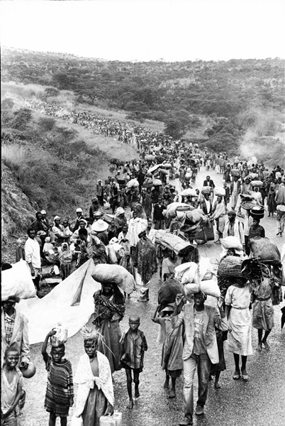
Shelter and Human migration
Global human migration
Migration from rural areas to urban areas
Migration from flooded or arid areas
Migration from overpopulated areas
Migration from low altitudes to high altitudes
Conflicts between countries may arise

Slide 14
Health Impacts
Malnutrition
Diarrheal Diseases
Vector borne diseases
Respiratory infections
Deaths and disease caused by heat waves, floods, droughts
Cardiovascular diseases
Allergies
Skin diseases caused by UV light
Water-borne disease (e.g. schistosomiasis, fasciolasis)

Slide 15
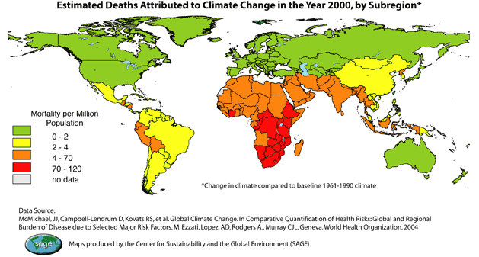
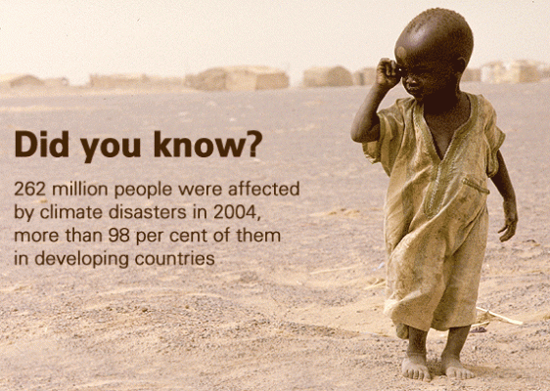
Impact on Mortality
Most affected:
People form developing countries
Children and elderly

Slide 16
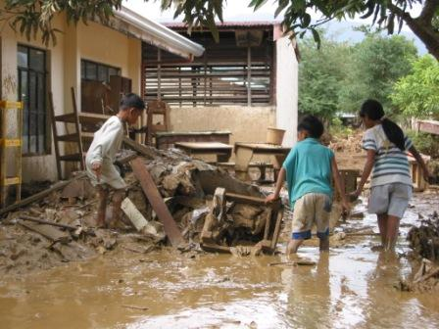
Research of effects of climate change on health
Evidences and projections on health effects
Adaptation capacity to a 3-4 oC rise in temperature

Slide 17
Malnutrition
Crops, forestry, livestock, fishery will be affected
Food insecurity
Chronic under nutrition will increase
Acute under nutrition will increase

Slide 18
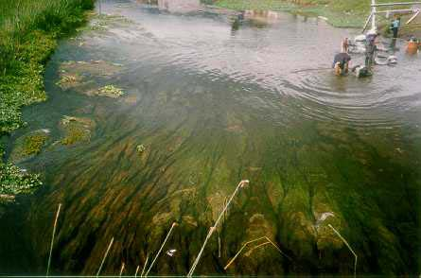
Water and Sanitation
Green algae blooms
Reduce rainfall
Unsafe water
Increase in diarrheal diseases
Increase in water-borne parasite diseases
Increase in fecal oral transmitted diseases

Slide 19
Water-borne Diseases
Algae blooms associated with: cholera, red tide intoxication, diarrheal diseases
Red tide algae blooms can cause respiratory diseases and skin diseases

Slide 20
Water-borne Diseases
Diarrheal Diseases can increase substantially. Among the gastrointestinal pathogens that may cause epidemic outbreaks:
V. Cholera
Salmonella
Cryptosporidium
Campylobacter

Slide 21
Water and Sanitation

Slide 22
Vector-borne Diseases
Morbidity and mortality caused by the following diseases will increase:
Malaria
Dengue
Leishmaniasis
West Nile Virus
Eastern Equine Encephalitis
Lime’s disease

Slide 23
Current malaria endemic areas (yellow) and areas were malaria map will expand (red)

Slide 24
Potential dengue transmission in case of temperature increase in the USA

Slide 25
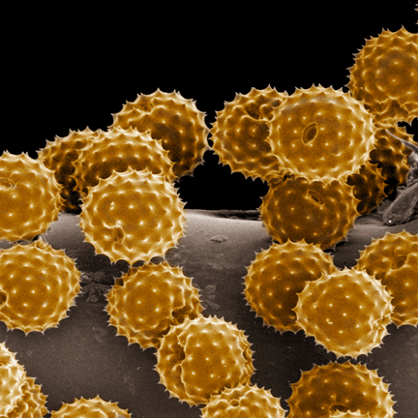
Respiratory Allergies
Climate Change will contribute to the increase of
Respiratory allergies
Asthma
Chronic obstructive diseases

Slide 26
Challenges to manage health impact of climate change
Changing patters of morbidity and mortality
Access to food
Water and sanitation
Housing and human settlements
Population growth and migration

Slide 27
Responses
Disease Surveillance
Food Security
Water and Sanitation
Shelter

Slide 28
Prevention strategies to reduce the impact
Vector-borne diseases control
Food security
Access to safe water and sanitation
Improved buildings
Reforestation
Family planning programs
Disaster risk assessment

Slide 29
How to reduce the adverse effects of climate change
Global policies to reduce carbon emission
Research should be done to establish causal relationships and associations between climate change and health
Interventions to reduce impact of climate change on human’s health

Slide 30
Attenuating the Impact of Adverse Health Effects
Vector control
Vaccines
Bed nets
Early diagnosis and treatment
Improve food access
Improve housing
Improve access to safe water and sanitation

Slide 31
Thanks

