Slide 1
COGNITIVE PSYCHOLOGY
Kenneth J. Malmberg, PhD

Slide 2
REHEARSAL
Kenneth J. Malmberg, PhD
Notes:
In our discussion of STM, recall that the modal model posits that memory is affected by the interaction of memory structures and control processes.
While there are potentially an unlimited number of control processes, Atkinson and Shiffrin extensively investigated rehearsal.
Rehearsal is the process by which an item is maintained in STM in order to be further processed, analyzed, or used to perform a more complex task.

Slide 3
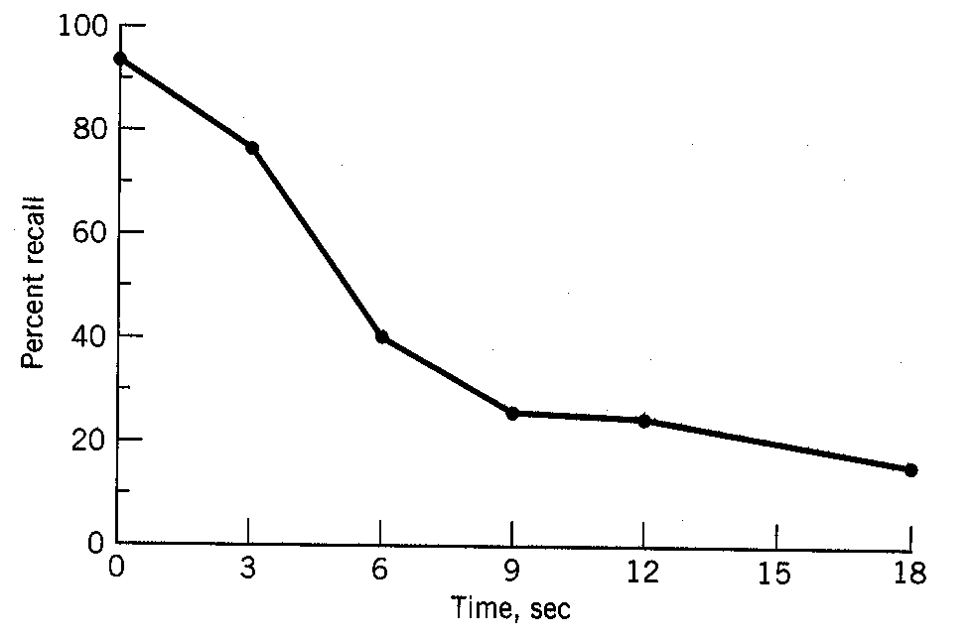
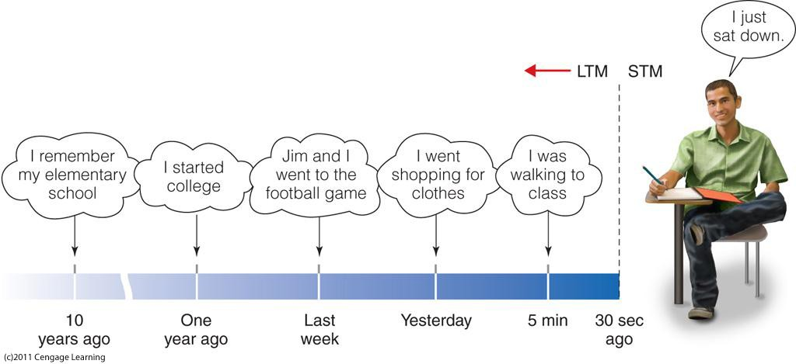
Duration of STM
Retention Interval Filled With a “Distractor Task”
Notes:
You will also recall from the last lecture that the Brown-Peterson task has been used to measure the duration of STM, and you will recall that the retention interval was filled with a distractor task.
The distractor task is designed to disrupt rehearsal.
When rehearsal is disrupted by a distractor task, Brown and Peterson were able to measure the duration of STM by plotting percent recall of the trigrams as a function of time.
You will also recall that performance on the Brown-Peterson task decreased to an asymptote.
Why wasn’t the item completely forgotten? According to the modal model this is because after about 15-20 s., a subject still might be able to retrieve the trigram from long-term memory.

Slide 4
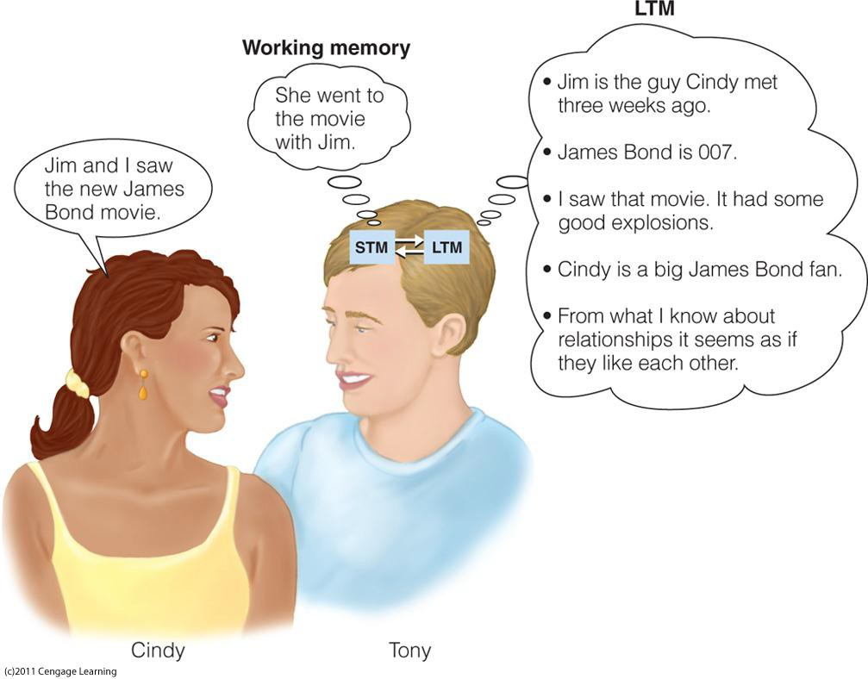
Relationship with STM and LTM
Notes:
The relationship between rehearsal, STM and LTM is an important one. This diagram illustrates that while the focus of the current conversation is in short-term memory, other thoughts associated with more distant events are being retrieved from long-term memory.

Slide 5
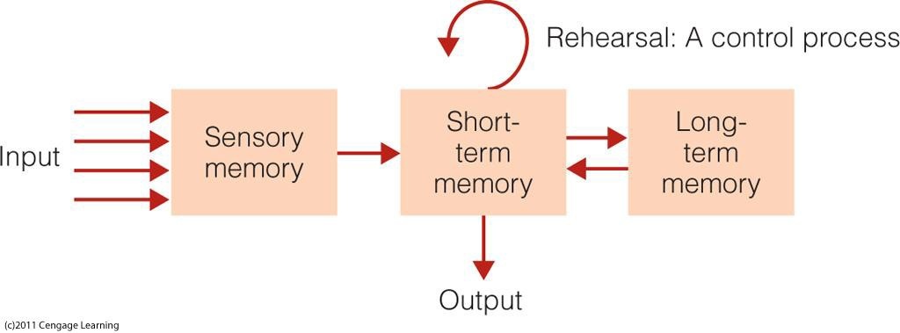
Rehearsal and Retention
!
The longer an item is rehearsed, the more likely it will be transferred to LTM
Notes:
One might suppose that the more time that is spent discussing an issue, the more likely this couple will be able to remember the conversation in the future.
Indeed, a critical assumption of the modal model is that greater the amount of time an item is rehearsed or spends in STM the more likely that information will be transmitted to LTM and thus the more likely it will be remembered in the distant future.

Slide 6
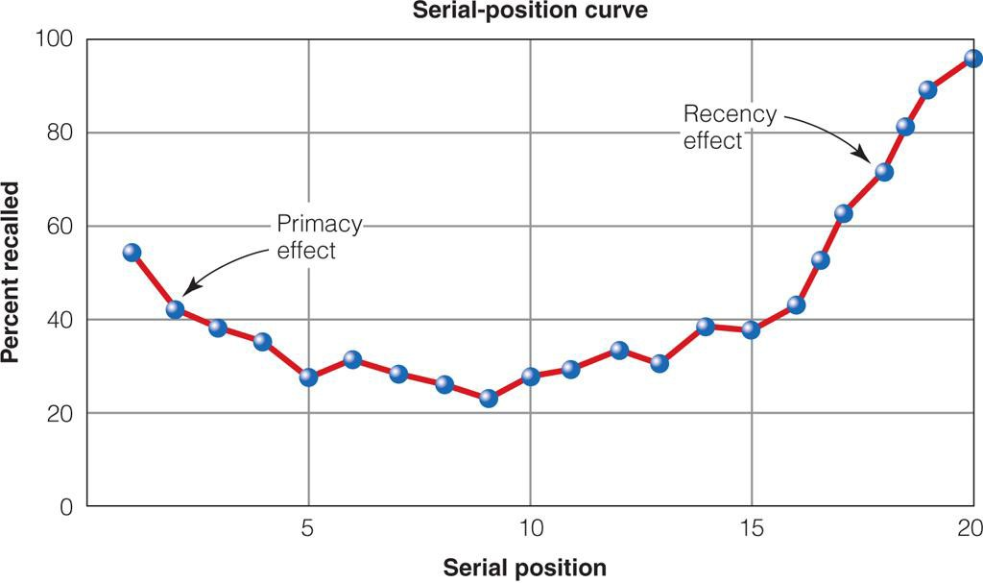
Primary and Recency Effects
Design:
Free Recall 20-item list
IV: serial position
DV: P(recal l)
According to the modal model:
Primacy is due to rehearsal advantages that items in early serial positions have.
Recency is due to retrieval from STM.
Notes:
These assumptions of the modal model allowed it to account for a commonly observed interaction that occurs when the ability to recall an item from a list is plotted against the serial position in which it was studied. This is called a serial position curve, and in the absence of a distractor task, it is U-shaped with items from the beginning of the list and the end of the list recalled the best. These are referred to as primacy and recency effects, respectively.
According to the modal model, the recency effect is due to very accurate retrieval from the contents of STM. You will remember that there may about 7 items in STM, and this serial position curve shows recency effects for about that many items.
The primacy effect is due to enhanced recall from LTM attributable to fact that items at the beginning of the list are given more rehearsal than items at the middle or the end of the list. Items at the beginning of the list get more rehearsal because initially the capacity of STM has not been reached. Thus, the first few items may be rehearsed with little competition from other items. Once the capacity of STM is reach then items from the beginning of this are dropped in favor of rehearsing newer items. Nevertheless, items at from the beginning of the list get more rehearsal and spend more time in STM than later items.

Slide 7
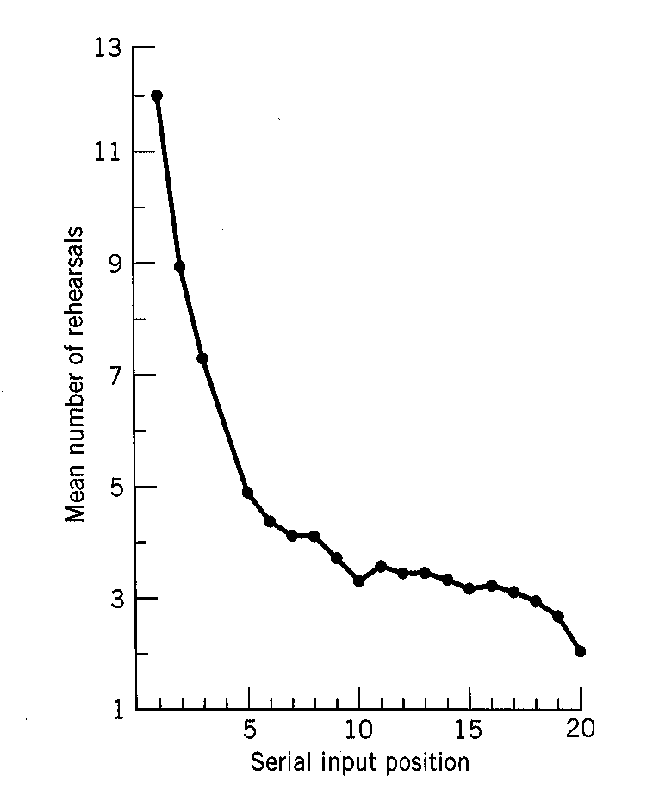
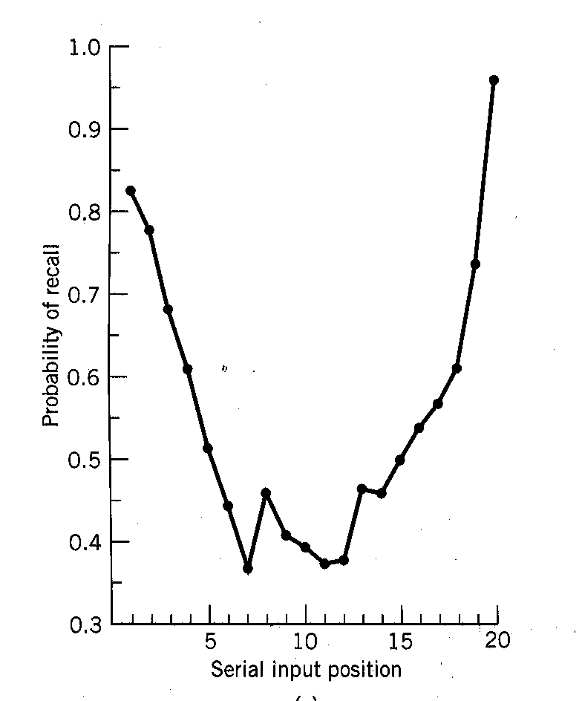
Rehearsal and Serial Position
Rundus (1971):
Counted the number of overt rehearsals
More rehearsals were given to items at the beginning of the list.
!
Recency effect is due to the advantage for recalling items from the short-term store
Notes:
The relationship between rehearsal and the serial position curve is shown here. While subjects studied a list of words, Rundus asked subjects to rehearse out loud. He recorded the rehearsals and counted them. On the right you can easily see that items from the beginning of the list received more rehearsal than other items. On the left you can see that the rehearsal advantage is related to the primacy effect but not due to the recency effect.

Slide 8
Serial Position and Memory Structure
Glanzer & Cunitz (1966):
Notes:
You will recall that the recency effect is due to accurate retrieval of the items in STM when remembering is initiated. The bottom panel shows what happens when a distractor task is inserted in the retention interval. Remember the distractor task is design to prevent rehearsal and after about 15-20 s. the context of STM has decayed according to the modal model. This is explains why the recency effect is only observed when there is no distractor task.
The top figure shows what happens when you vary the amount of time that items are studied. This should increase the number of rehearsals each gets, and according to the modal model then we would expect the primacy but not the recency portion of the serial position curve to improve. This is exactly what is commonly observed.

Slide 9
Study Guide 1
True or False?
The distractor task used in the Brown-Peterson procedure causes people to forget.
True
False

Slide 10
Study Guide 1
True or False?
The distractor task used in the Brown-Paterson procedure causes people to forget.
True
False

Slide 11
Study Guide 2
True or False?
The primacy and recency effects are due to retrieval from STM.
True
False

Slide 12
Study Guide 2
True or False?
The primacy and recency effects are due to retrieval from STM.
True
False

Slide 13
Study Guide 3
True or False?
The number of rehearsal predicts free recall performance.
True
False

Slide 14
Study Guide 3
True or False?
The number of rehearsal predicts free recall performance.
True
False

Slide 15
Study Guide 4
True or False?
Information resides in STM for 15-20s without rehearsal.
True
False

Slide 16
Study Guide 4
True or False?
Information resides in STM for 15-20s without rehearsal.
True
False

Slide 17
Study Guide 5
True or False?
The serial position curve increases and the parallel position curve remains constant.
True
False

Slide 18
Study Guide 5
True or False?
The serial position curve increases and the parallel position curve remains constant.
True
False

