Slide 1
COGNITIVE PSYCHOLOGY
Kenneth J. Malmberg, PhD

Slide 2
PROCESSING
Kenneth J. Malmberg, PhD
Notes:
As a memory researcher, I have countless conversations that go something like this. (Actually they go exactly like this.)
“Hi, I am so-and-so.”
“Hi, I am Ken.”
“What do you do for living, Ken?”
“I am psychologist.”
“OOO—you must be reading my mind.”
“No, no. I am not that type of psychologist. I don’t really care what you’re thinking about.”
“What kind of psychologist are you?”
“I study human memory.”
“Oh, I should be subject in one your experiments. I have a terrible short-term memory. Is there anything I can do to improve my memory?”
Remember the relationship between IQ and STM? This person has just indicated to me that he is mentally retarded. Not really, but he doesn’t know the difference between long-term and short-term memory. Not surprisingly, he wants to improve his memory.
Well, it turns out there are number of things that you can do to help you remember.

Slide 3
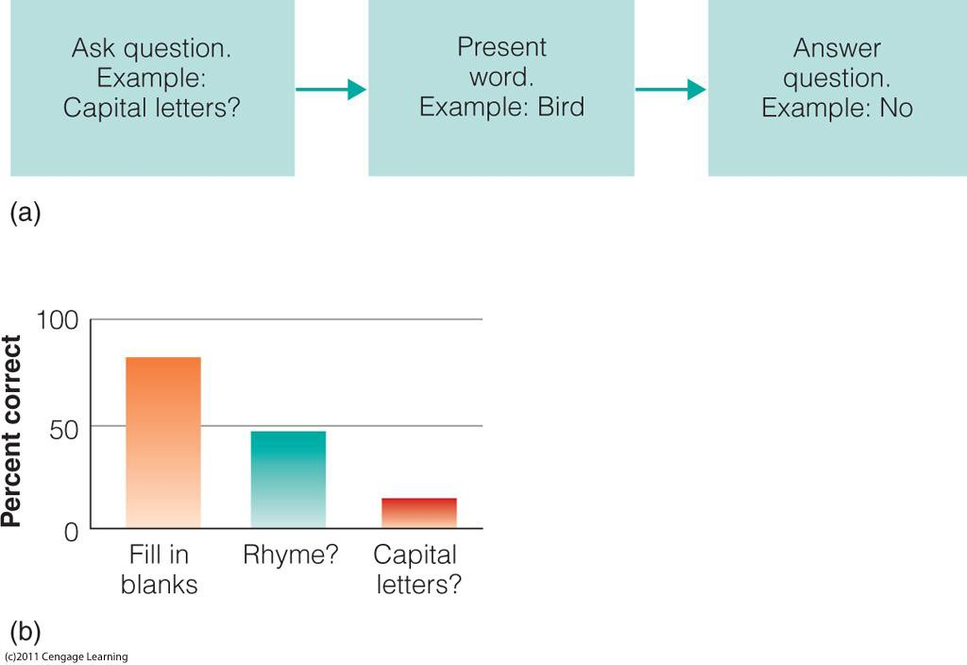
Levels of Processing
Craik and Lockhart (1972):
Notes:
Recall the modal model assumes that control processes affect the extent to which items are encoded in long-term memory. For instance, the longer one studies an item, the more likely it will be retrieved from LTM later.
That is because the item receives more rehearsals. In addition, according to levels of processing theory, different types of rehearsal or encoding operations can improve LTM. The key distinction is between deep and shallow levels processing.
Deep processing requires the attention to be focused on the meaning of what is to be remembered. Another way of thinking about deep processing is that you integrate what you want to remember with what you already know about the world.
Shallow level processing focuses on rote rehearsal or attending to the surface structure of what is to be remembered, such as phonology.
In this example, the subjects were told that they would be presented with a list of words to be remembered later. Prior to each word being a presented, the subjects were asked to answer one of three questions that varied in depth of processing.
For instance, they might have been asked if the word was in uppercase letters, which is shallow level task. Or they have been presented with a word fragment and they had to fill in the blanks in order to complete the word, which is deep level task. As you can see, performance was best when processing was the deepest.

Slide 4
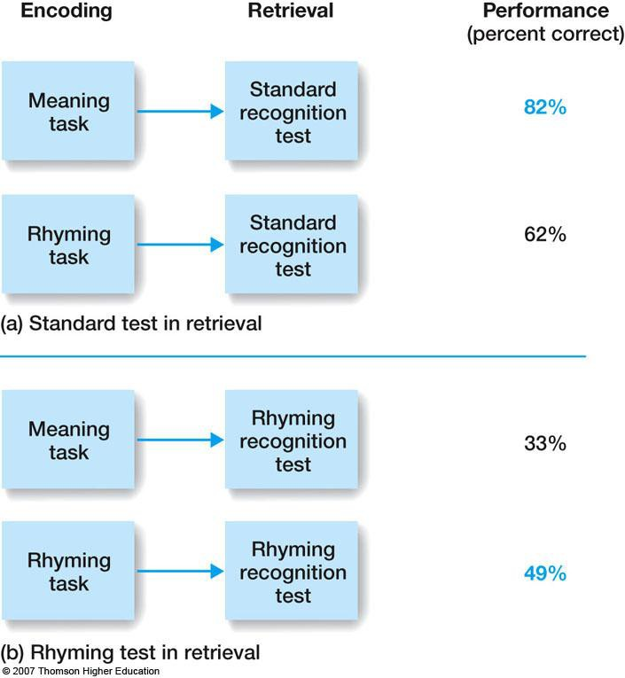
Transfer Appropriate Processing
Notes:
Transfer appropriate processing focus on the correspondence between the processing that occurred during study and the processing that occurs at test. When the testing conditions match the manner in which items were encoded, memory is predicted to be best.
In this example, we see the standard levels of processing effect in the top condition--deep is better than shallow . However, in the bottom condition subjects are given a recognition task that emphasizes phonology. They were specifically asked if word that rhymes with the test items was on the study list.
As transfer appropriate processing predicted, recognition was better when items were encoded in terms of their phonology instead of their meaning. The key thing here is: Study conditions should match test conditions for optimal memory.

Slide 5
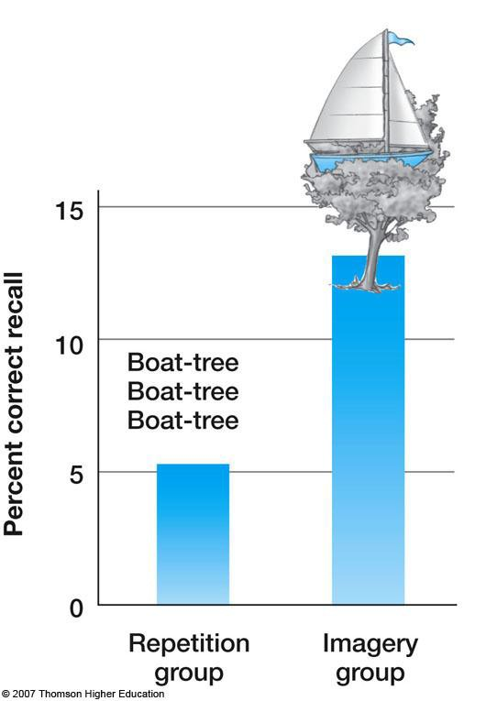
Imagery
Bower and Winzenz (1970):
Notes:
Recall that the Working Memory theory posited a phonological loop and visuospatial sketchpad. The loop and sketchpad are thought to support auditory and visual memory, respectively. In a clever experiment by Bower, the interaction of these forms was investigated.
The subjects were give a pair of items to be remembered such that if given one of the items they could recall the item it was paired with. In one condition, subjects were instructed to say the pair of words over and over again in their head.
In the other condition, subjects were instructed to create an interactive image of the words. Note that the interactive imagery instructions enhanced memory above what was observed when items were simply rehearsed. It seems as though there are indeed two different types of memories that can be stored.

Slide 6
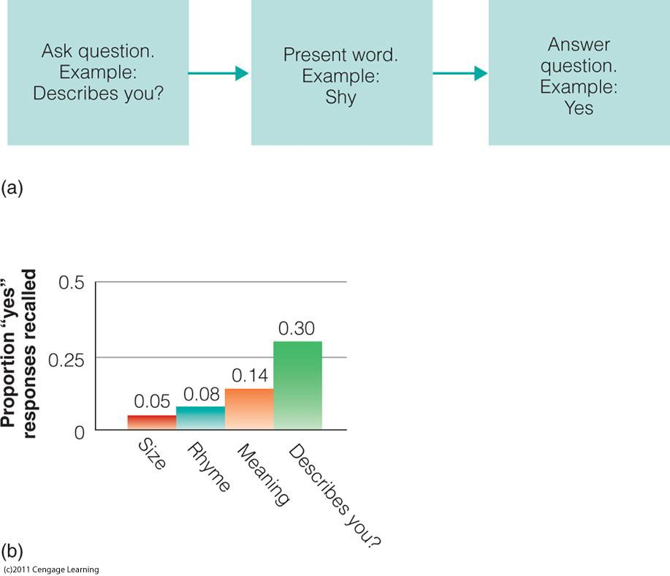
Self Reference Effect
Rogers et al. (1979)
Notes:
We have seen that instructions that require the processing of the meaning of to-be-remember information enhance memory. Perhaps the best way of processing the meaning of an item is relating that item to something that you know about yourself.
Here are the results of an experiment by Rogers et al., 1979. In one condition subjects were told to rate the length of a word and in the other condition subjects were asked if the word described them. Relating the word to what they knew about themselves greatly enhanced memory.

Slide 7
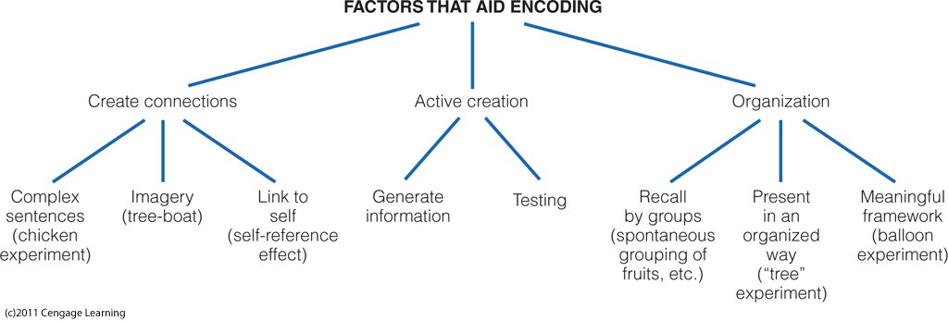
Improving Memory
Memory can be improved in variety of ways:
Notes:
Research over the years has determined that there are number of ways that long-term memory can improved.
When studying a set of information, it helps to create connection between the items. These connections are sometime called associations. For example, one could create sentences out of the items being studied, one could create visual images out of the items, or link the items to one self.
Another way to improve long-term memory is actively create from one’s own mind the items one wishes to remember. This related to common way that students study for exams using flash cards. Testing your memory often improves long-term memory not only because retrieval practice is beneficial, but also because it helps students determine what they know and they do not.
Last, following Miller’s advice concerning chunking, organizing the to be learned material in a non random manner facilitates long-term memory.
Note that all of these strategies require the controlled processing of information in STM in order in order to effectively encode information in long-term memory. Hence, it is not surprising that those people will damage to STM have more a more difficult time learning and remembering.

Slide 8
Study Guide 1
True or False? People with greater memory spans tend to have higher IQs.
True
False

Slide 9
Study Guide 1
True or False? People with greater memory spans tend to have higher IQs.
True
False

Slide 10
Study Guide 2
True or False? Shallow processing during study improves memory.
True
False

Slide 11
Study Guide 2
True or False? Shallow processing during study improves memory.
True
False

Slide 12
Study Guide 3
True or False? Creating a sentence out of a word that you are trying to remember is an example of shallow processing.
True
False

Slide 13
Study Guide 3
True or False? Creating a sentence out of a word that you are trying to remember is an example of shallow processing.
True
False

Slide 14
Study Guide 4
True or False? The manner in which memory is tested has no impact on how you should study.
True
False

Slide 15
Study Guide 4
True or False? The manner in which memory is tested has no impact on how you should study.
True
False

Slide 16
Study Guide 5
True or False? Relating information to aspects of yourself will help you remember that information.
True
False

Slide 17
Study Guide 5
True or False? Relating information to aspects of yourself will help you remember that information.
True
False

