Slide 1
COGNITIVE PSYCHOLOGY
Kenneth J. Malmberg, PhD

Slide 2
NEURO-BASIS OF MEMORY
Kenneth J. Malmberg, PhD
Notes:
In the first section this course, we had a couple of lectures on how neurons supported cognition. One of the most important areas of research is how experiences influence our brain. Each experience of our life modifies our brains. These modifications support learning and memory.

Slide 3
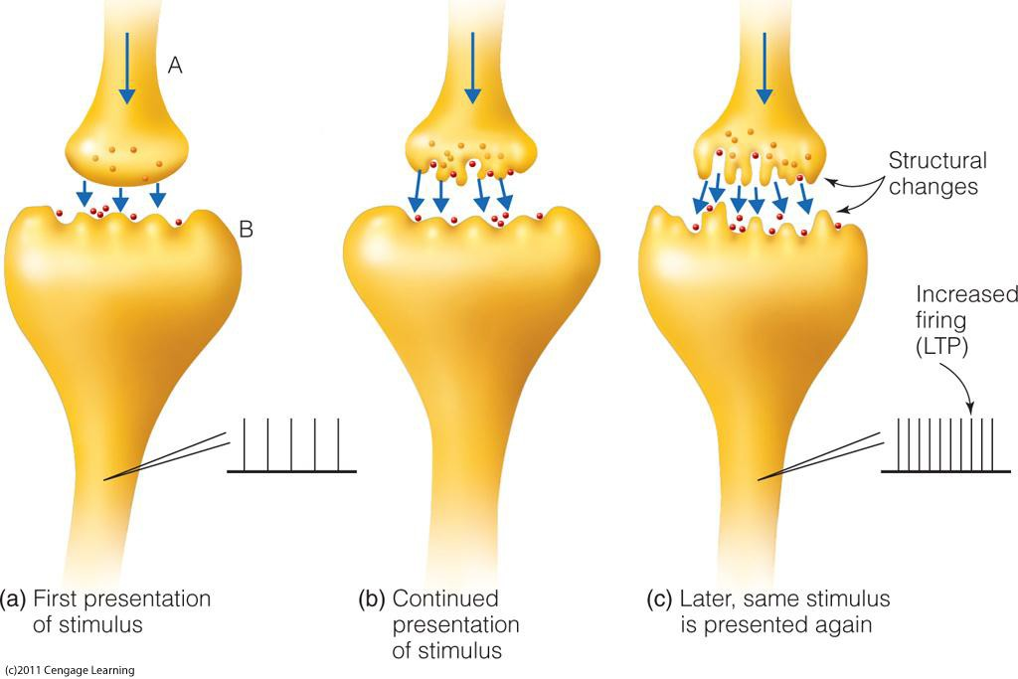
Long-Term Memory at the Synapse
How are memories stored in the Brain?
Notes:
You will recall that neurons communicate by sending information to each other in the form of neurotransmitters at synapses. Synapses are where the axon of one neuron releases neurotransmitters that influence the activity of firing rate of the receiving neuron.
In Figure A, a synapse is shown during the first presentation of a stimulus. Neurotransmitters are released as the receiving neuron fires weakly.
Upon continued presentation of the stimulus, the synapse undergoes a physical change. The surface of the axon and the dendrite becomes more irregular. That is, as the surface areas increase, this allows more neurotransmitters to be released by the axon and absorbed by the dendrite.
As a result, the firing rate of the receiving neuron increases.
This is how one neuron learns to respond to a stimulus.

Slide 4
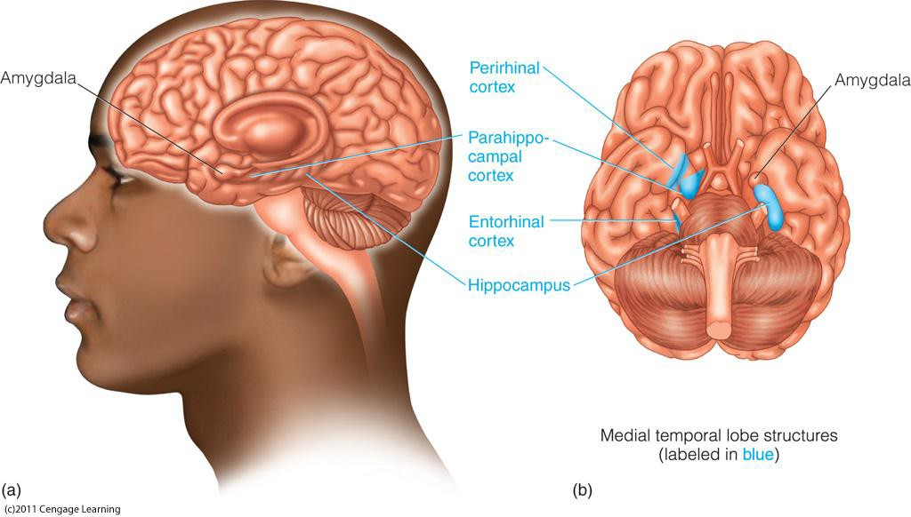
Long-Term Memory in the Brain
Where are the memories stored?
Notes:
The main areas of the brain that support memory are very primitive and they are located in the medial temporal lobe. Medial means that they are located in the center of the brain and temporal means they are located between our temples.
Some of the most important learning occurs when two very important areas of the brain interact. They are hippocampus and the amygdala. The hippocampus is thought to organize the storage of new memories in a manner that they can be later retrieved.
The amygdala is the center for emotion, and it directs the hippocampus to store those events or stimuli that have the greatest consequences. That is, the stimuli that produce high costs and high rewards.

Slide 5
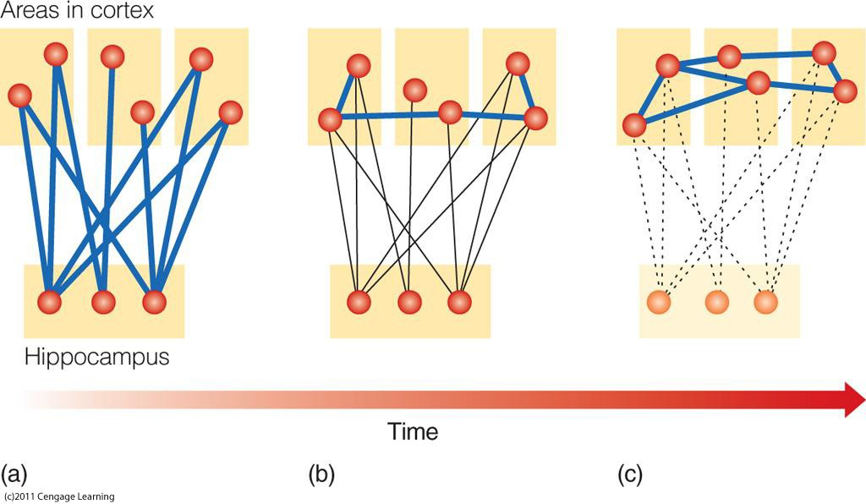
Consolidation and LTM
Consolidation: A transformation of recent memories into a more permanent state.
Notes:
The preferential storage of traces that represent important events occurs during a process known as consolidation. Initially, the hippocampus creates new connections with cortical areas of the brain. Note that the cortical areas do not initially become connected themselves.
However over time they do, and the connections that were formed from the hippocampus to the cortical areas weaken. This is the consolidation process, and it's what creates permanent memories of important events.

Slide 6
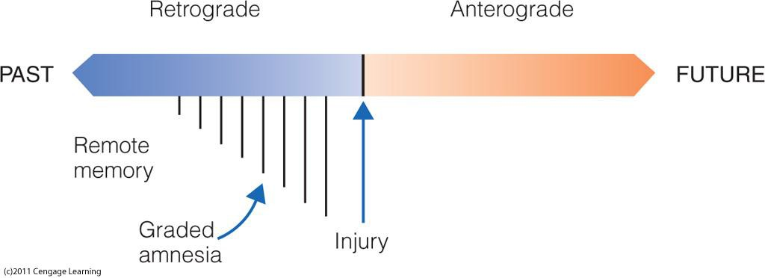
Consolidation and Amnesia
Notes:
Evidence supporting the consolidation process comes from studies of people with head trauma. Some of you may have been in a car accident or been in a football game and been knocked unconscious.
Often what happens as the result of this trauma is that there is memory loss for what caused the trauma and perhaps for 45 minutes to an hour before the accident. This is known a retrograde graded amnesia.
It is retrograde amnesia because memory is lost for the events occur prior to the trauma. It is graded amnesia because the events that occurred closest in time to the trauma are most likely to have been forgotten. This loss of memory is thought to be the result of a disruption in the consolidation process.

Slide 7
Further Videos
Please follow the link given in the Canvas module to the Scientific American Frontiers video:
Watch these three segments. These are excellent tutorials that give real world examples of the neuro-basis of memory:
Yesterday is Gone
Never Forget A Face
Why Memories Last
Notes:
https://www.youtube.com/watch?v=7Grh3PeEMIg
What I would like you to do now is watch a couple of short segments from a Scientific American Frontiers episode on memory. In the first episode, you will be meet EP, a man with severe anterograde amnesia.
That is, EP cannot remember anything that happened to him after a disease harmed his medial temporal lobe. In the second segment, you will see how fMRI is used to investigate the operations of the hippocampus, and in the third segment you will see how the amygdala and the hippocampus interact to create long lasting memories.

Slide 8
Study Guide 1
True or False? The influence of a sending neuron on a receiving neuron increases as the results of a physical change in the axon and dendrite at the synapse.
True
False

Slide 9
Study Guide 1
True or False? The influence of a sending neuron on a receiving neuron increases as the results of a physical change in the axon and dendrite at the synapse.
True
False

Slide 10
Study Guide 2
True or False? The hippocampus is the brain area involved in emotion.
True
False

Slide 11
Study Guide 2
True or False? The hippocampus is the brain area involved in emotion.
True
False

Slide 12
Study Guide 3
True or False? The amygdale influences the activity of the hippocampus.
True
False

Slide 13
Study Guide 3
True or False? The amygdale influences the activity of the hippocampus.
True
False

Slide 14
Study Guide 4
True or False? Consolidation occurs in the first 1 to 2 minutes after an event.
True
False

Slide 15
Study Guide 4
True or False? Consolidation occurs in the first 1 to 2 minutes after an event.
True
False

Slide 16
Study Guide 5
True or False? In the Scientific American Frontiers segment on the amnesic EP, EP was unable to remember his name.
True
False

Slide 17
Study Guide 5
True or False? In the Scientific American Frontiers segment on the amnesic EP, EP was unable to remember his name.
True
False

