Slide 1
COGNITIVE PSYCHOLOGY
Kenneth J. Malmberg, PhD

Slide 2
THE MODAL MODEL
Kenneth J. Malmberg, PhD
Notes:
In this section, we turn our attention from how we experience the present to how we experience the past.

Slide 3
Importance of Memory
!
Everything in life is memory, save the thin edge of the present.- Michael Gazzaniga
Psychology would be almost completely uninteresting and not worth studying if
it were not for memory.
?
How do we remember? Why do we forget? How am I different from other people? Why am I different from other people?
MEMORY
Memory is the acquisition, representation, and retrieval of information.
Notes:
Someone once said that “Everything in life is memory, except for the thin edge of the present”.
I agree wholeheartedly with the statement. It is easy for me to make the case that all psychologists are in large part memory researchers. Those who claim that they are not either have not thought hard enough about their subject or they are not actually psychologists for those who study objects that do not have the capacity of memory, are probably studying something like rocks.
Those of you who have witnessed the effects of late stage Alzheimer’s Disease on a loved one, I am sure would agree. When you take memory out of the equation, the person is not really the same person anymore.
Before moving too far along, however, we need a working definition of memory to guide our discussions.
Memory is the acquisition, representation, and retrieval of information.

Slide 4
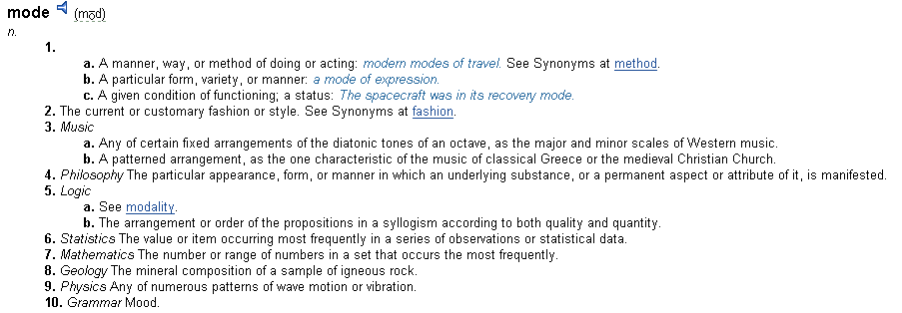
Modal?
Atkinson & Shiffrin (1968)
Notes:
Almost everyone would accept this definition of memory. Indeed, it allows for a lot of wiggle room.
We will explore memory in the context of a more specific set of assumptions, namely those provided by what Murdoch referred to as the modal model.
Why is our theoretical framework called the Modal Model?
You all recall from stats that there are several measures of central tendency: the mean, median, and the mode.
The mode is simply the most common observation or member of a set.
The modal model is the most common way of thinking about memory.

Slide 5
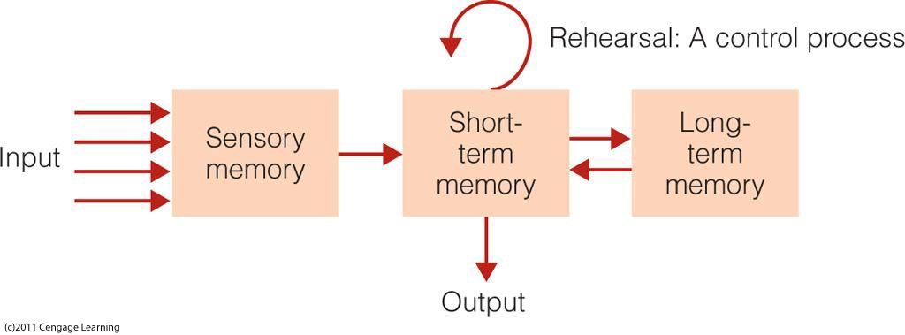
The Modal Model: Structure
The Modal Model - Atkinson & Shiffrin (1968)
Structures: Invariant properties of memory
Sensory Memory: holds all incoming information for seconds or fractions of seconds
Short-term Memory (STM): limited capacity, holds information for 15-30 seconds
Long-term Memory (LTM): holds large amount of information perhaps permanently
Notes:
The modal model has a long history, going back at least to the work of James, but it was concretely described in a series of articles by Atkinson & Shiffrin in the 1960s and 1970s.
According to the modal model, memory consists of set of memory structures and control processes.
The memory structures are invariant properties of memory. There are three of them.
Sensory Memory holds all incoming information for seconds or fractions of seconds. This is what was meant by only the thin edge of the present is not memory.
Short-term Memory (STM) has a limited capacity, and holds information for about 15-30 seconds.
Long-term Memory (LTM) permanently holds a large amount of information.

Slide 6
The Modal Model: Control
The Modal Model - Atkinson & Shiffrin (1968)
Control Processes: Processes influence how information is used
Rehearsal: repetition of an item in one’s head
Mental Rotation: as in Shepard and Metzler's mental rotation experiment.
Sentence Creation: to enhance memory etc.
Notes:
Control Processes influence how information is used. There are a wide variety of control processes. In fact, there may be as many types of control processes as there are tasks. Some of the more common ones that we consider in memory research are:
• Rehearsal: repetition of an phone number in one’s head
• Mental Rotation, which you will experience in one of your future CogLab assignments
• Sentence Creation: to enhance memory when studying a list of words Etc.

Slide 7
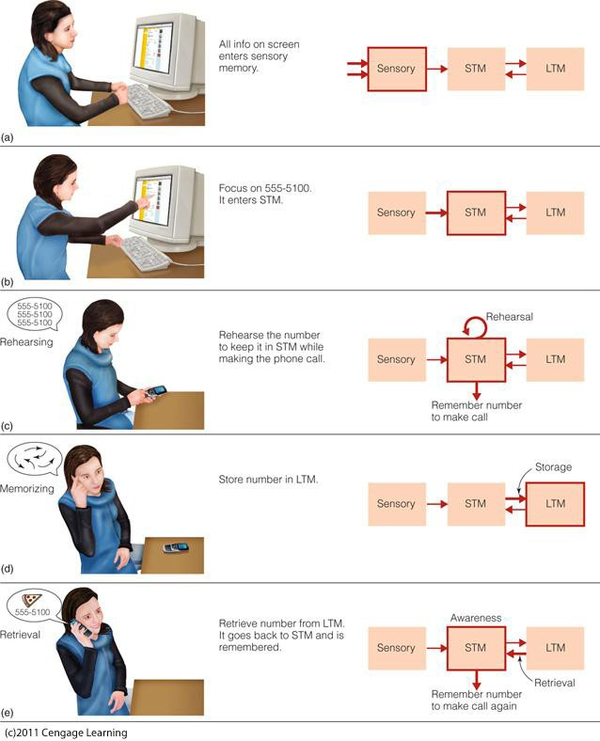
Control of Memory Systems
Notes:
According to the modal model, information interacts with control process in order to flow through the memory structures.
Depending on what we are doing, the control of memory allows us to perform certain tasks or meet our goals.
In subsequent lectures, we will delve into each memory structure and various control processes in greater detail.
For now, here is an old fashion example of the control of information in memory.
We see someone working on a computer and trying to remember a phone number so she can order a pizza.
Initially, the contents of visual sensory memory is a representation of what appears on the computer monitor.
Remember from the first module that visual representation of the environment are not necessarily complete or accurate.
One part of the screen has attracted her attention. It is the phone number of pizza joint. That phone number is selected to be transferred to short-term memory.
She reaches for her phone and all of sudden of the computer has disappeared!
Now she must maintain the phone number if STM and as a result the phone number gets stored in long-term memory.
The next time she wants to order a pizza, she retrieves the phone number from long-term memory.
That is, the phone number is again the focus of attention on short-term memory.
These days she would probably just use her phone to place the pizza order, and it is interesting think about how technology supports our cognitive processes.
It is also interesting to think about how similar memory processes allow us to remember what we had for dinner the night before last, or what the contents of module 1 were.

Slide 8
Study Guide 1
True or False? Memory is the acquisition, representation, and retrieval of information.
True
False

Slide 9
Study Guide 1
True or False? Memory is the acquisition, representation, and retrieval of information.
True
False

Slide 10
Study Guide 2
True or False? The modal model is the most common way of thinking about memory.
True
False

Slide 11
Study Guide 2
True or False? The modal model is the most common way of thinking about memory.
True
False

Slide 12
Study Guide 3
True or False? According to the modal model, memory is only a set of memory structures.
True
False

Slide 13
Study Guide 3
True or False? According to the modal model, memory is only a set of memory structures.
True
False

Slide 14
Study Guide 4
True or False? Control processes influence how memories are stored and retrieved.
True
False

Slide 15
Study Guide 4
True or False? Control processes influence how memories are stored and retrieved.
True
False

Slide 16
Study Guide 5
True or False? Once information is lost from short-term memory it may never be retrieved.
True
False

Slide 17
Study Guide 5
True or False? Once information is lost from short-term memory it may never be retrieved.
True
False

Slide 18
Study Guide 6
True or False? Long-term memory is permanent according to the modal model.
True
False

Slide 19
Study Guide 6
True or False? Long-term memory is permanent according to the modal model.
True
False

