Slide 1
COGNITIVE PSYCHOLOGY
Kenneth J. Malmberg, PhD

Slide 2
INFERENTIAL MEMORY
Kenneth J. Malmberg, PhD
Notes:
One of the big ideas in this class is that much of the craziness that we observe in our behavior and the behavior of others is the result of the manner in which the cognitive system overcomes limits on the amount and quality of information that it has to work with.
Because of these limitations, we are often left to make inferences. We saw examples of this in our discussions of perception and attention.
It’s probably not surprising then that memories are also based in part inferences. This is because the encoding of new memories is incomplete and error prone. Given the noisy nature of encoding, the system must make inferences about what we have experienced in the past.
These inferences are based on our knowledge about the way the world typically works. Of course, everyone has different experiences and therefore they also possess different knowledge about the world. This fact actually explains quite a bit.
For instance, it explains why two people and experience the exact same event, but remember the details of what happened very differently. I am sure that you have arguments in the past, with friends or families about something that did or did not occur the way you thought it did.
There is no winning discussions like these. Not only did your knowledge about the world affect what you experienced, but it also affects what you remember. Here is a good example.

Slide 3
Making Inferences: Examples
The children’s snowman vanished when the temperature reached 80.
The flimsy shelf weakened under the weight of the books.
The absent-minded professor didn’t have his car keys.
The karate champion hit the cinder block.
The new baby stayed awake all night.
Notes:
Read these sentences and try to remember them.
The children’s snowman vanished when the temperature reached 80.
The flimsy shelf weakened under the weight of the books.
The absent-minded professor didn’t have his car keys.
The karate champion hit the cinder block.
The new baby stayed awake all night.

Slide 4
Making Inferences: Test
The flimsy shelf ______________ under the weight of the books.
The children’s snowman _________________ when the temperature reached 80.
The absent-minded professor didn’t have his car keys.
The new baby __________________ all night.
The karate champion _____________ the cinder block.
Notes:
OK, now take out a piece of paper and fill in the blanks with words from the sentences that you just read.

Slide 5
Typical Inferential Errors
The children’s snowman vanished when the temperature reached 80.
The flimsy shelf weakened under the weight of the books.
The absent-minded professor didn’t have his car keys.
The karate champion hit the cinder block.
The new baby stayed awake all night.
Most common errors:
Vanished became melted, weakened became collapsed, didn’t have became lost, hit became broke or smashed, stayed awake became cried.
Notes:
OK. Here are the sentences again. Did you make any mistakes? Almost all of you did. In fact, I know what errors you most likely made.
Most common errors are : Vanished became melted,
In other words, "The children's snowman vanished when the temperature reached eighty" became in your mind "The children's snowman melted when the temperature reached eighty" weakened became collapsed, didn’t have became lost, hit became broke or smashed, stayed awake became cried.
Note these errors are not random. First, I could predict which errors you would make. Second, your errors made sense. What you did when you were studying these sentences was infer something occurred when it did not occur.
For instance, when you read about the snowman vanishing a hot day you inferred that it must have melted. However, the sentence did not say this. The snowman may have been stolen, for instance.

Slide 6
Pragmatic Inference Experiment
The errors are based on pragmatic inferences.
This occurs when reading a sentence leads a person to expect something that is not explicitly stated.
Bransford & Johnson (1973)
Control Group: John was trying to fix the birdhouse. He was looking for the nail when his father came out to watch him and help him do the work.
Experimental Group: John was trying to fix the birdhouse. He was pounding the nail when his father came out to watch him and help him do the work.
Test: Experimental Group: John was using a hammer to fix the birdhouse when his father came out to watch him and help him do the work.
Notes:
These errors are based on what are known as pragmatic inferences. This occurs when reading a sentence leads a person to expect something that is not explicitly stated.
Here is another example form an experiment by Bransford and Johnson.
Subjects read a list of sentences.
In the Control Group subjects read a sentence like: John was trying to fix the birdhouse. He was looking for the nail when his father came out to watch him and help him do the work. The key word here is “looking”.
In the Experimental Group subjects read a different sentence: John was trying to fix the birdhouse. He was pounding the nail when his father came out to watch him and help him do the work. The key word here is “pounding”.
Note neither sentence says anything about a hammer. If John is like my wife, he was probably pounding the nail with closest heavy object he could find.

Slide 7
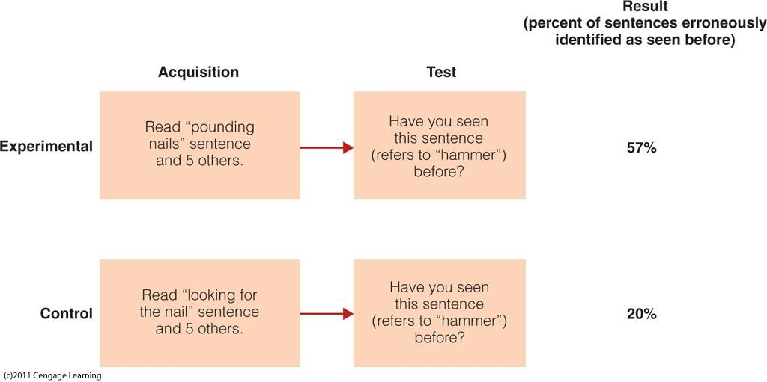
Pragmatic Inference: Experiment Design
The errors are based on pragmatic inferences.
This occurs when reading a sentence leads a person to expect something that is not explicitly stated.
Bransford & Johnson (1973)
Notes:
At test groups were tested with the sentence: "John was using a hammer to fix the birdhouse when his father came out to watch him and help him do the work.”
The group that read a sentence that indicated that John was pounding nails was 4 times more likely to say they read this sentence than the group that read the sentence that indicated that John was looking for nails.
In other words, the word "pounding," led subjects to believe he was using a hammer.

Slide 8
Pragmatic Inference and Perception
The errors are based on pragmatic inferences.
This occurs when reading a sentence leads a person to expect something that is not explicitly stated.
?
How does this relate to Helmholtz’s unconscious inference?
Notes:
Thus, the mind often infers the presence of things that are not based on what is actually present. See if you can relate these ideas to Helmholtz’s ideas about unconscious inference.

Slide 9
Study Guide 1
True or False? One of the big ideas in this class is that much of the craziness that we observe in our behavior and the behavior of other is result of the manner in which the cognitive system overcomes limits on the amount and quality of information that has to work with.
True
False

Slide 10
Study Guide 1
True or False? One of the big ideas in this class is that much of the craziness that we observe in our behavior and the behavior of other is result of the manner in which the cognitive system overcomes limits on the amount and quality of information that has to work with.
True
False

Slide 11
Study Guide 2
True or False? Memories are encoded completely and without error.
True
False

Slide 12
Study Guide 2
True or False? Memories are encoded completely and without error.
True
False

Slide 13
Study Guide 3
True or False? Our own knowledge of the world affects our experience and therefore what we remember.
True
False

Slide 14
Study Guide 3
True or False? Our own knowledge of the world affects our experience and therefore what we remember.
True
False

Slide 15
Study Guide 4
True or False? Our memories can be affected by the suggestions of others.
True
False

Slide 16
Study Guide 4
True or False? Our memories can be affected by the suggestions of others.
True
False

Slide 17
Study Guide 5
True or False? We often read into situations things that did not actually occur.
True
False

Slide 18
Study Guide 5
True or False? We often read into situations things that did not actually occur.
True
False

