Slide 1
COGNITIVE PSYCHOLOGY
Kenneth J. Malmberg, PhD

Slide 2
IMPLICIT MEMORY
Kenneth J. Malmberg, PhD
Notes:
Over the last few lectures we explored how control processes interact with memory structures to enhance memory. A fundamental aspect of these discussions is the notion that we have control over our memory.
However, in many circumstance we do not have control over memory. Indeed, we are largely unaware of the fact our memories are being enhanced or even contaminated. Because we are unaware of these influences, our daily behavior may seem odd.
Implicit memory effects are those that alter our behavior without us knowing it. Before turning to this discussion, however, I want you to try to remember this list of words.

Slide 3
Memory Activity
Remember these words:
bench
bush
journal
table
picture
Notes:
OK got it?

Slide 4
Types of Long-Term Memory
Declarative (Episodic and Semantic)
Implicit Memory (Priming)
Procedural
Notes:
There are three fundamental forms of memory.
Declarative memories are memories of events or knowledge about the world. These forms of memory are often referred to as episodic and semantic memory. We have already spent a great deal of time discussing episodic memory and we will discuss semantic memory a great deal in Section 3 of this course.
A key quality of these memories is that retrieval of these memories if often accomplished under our control.
Implicit Memory on the other hand influences our behavior without our knowledge. Sometimes a recent event will facilitate the performance of some task even when retrieval of a memory for that event is not required in order to accomplish the task. This is referred to as priming.
Procedural memory is memory for how to do things, such as driving a car or typing. These memories are extremely resistant to forgetting, and may be acquired even by amnesiacs.

Slide 5
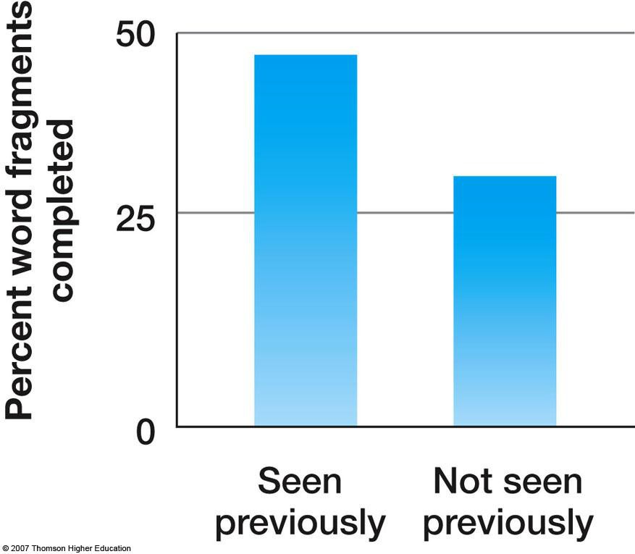
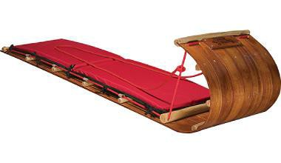
Implicit Memory: Example Task
Word fragment completion task: t_bo_g_n
Notes:
Here are the results of an experiment that investigated implicit memory.
In the first stage of the experiment, subjects are presented with a list words to something with. For instance, when a word appeared on the screen they may been asked to rate on scale of 1 to 4 how pleasant the word’s meaning is.
After a break, the subjects are given an unrelated task. In this case, it was word fragment completion task. For instance, the subjects may have been given this word fragment, and their task was to provide the missing letters for toboggan. This is, in fact, fairly difficult if enough letters are missing.
Some of the fragments when completed formed the words seen previously in the first stage of the experiment. In other words, these fragments were primed. Here you can see that the subject’s ability to complete the fragments was enhanced by their recent encounter with the word.

Slide 6
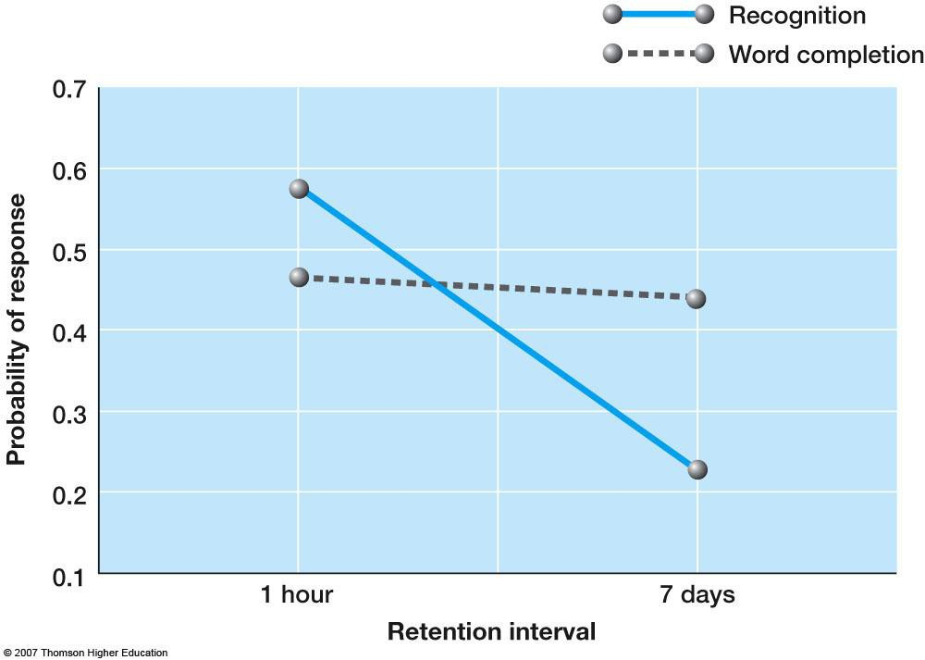
Implicit VS Episodic Memory
Word fragment completion task: t_bo_g_n
Notes:
There is some evidence that this form of implicit memory is distinct from episodic memory.
Note that there were actually two retention intervals used in this experiment, 1 day and 7 days, and the subject’s memory was tested using a recognition procedure in addition to the word fragment completion task.
After seven days, recognition memory became quite poor, but the amount of priming observed remained almost unaffected by the delay.

Slide 7
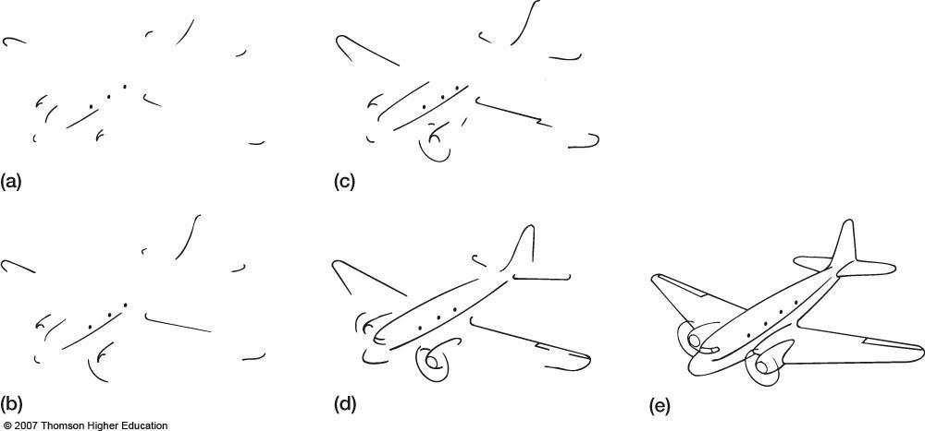
Implicit Memory and Amnesia
Warrington and Weiskrantz (1968):
Notes:
Another form of evidence that implicit memory is distinct from episodic memory comes from the study of amnesic patients. These patients are unable to acquire memories for events that occur after some brain trauma or disease.
To investigate implicit memory in amnesiacs, Warrington and Weizkrantz trained subjects over three sessions to identify incomplete line drawings by presenting the patients more and more complete drawings until they could be identified.
In this case, this is a drawing of a plane. The question is could the amnesic patients acquire new memories?

Slide 8
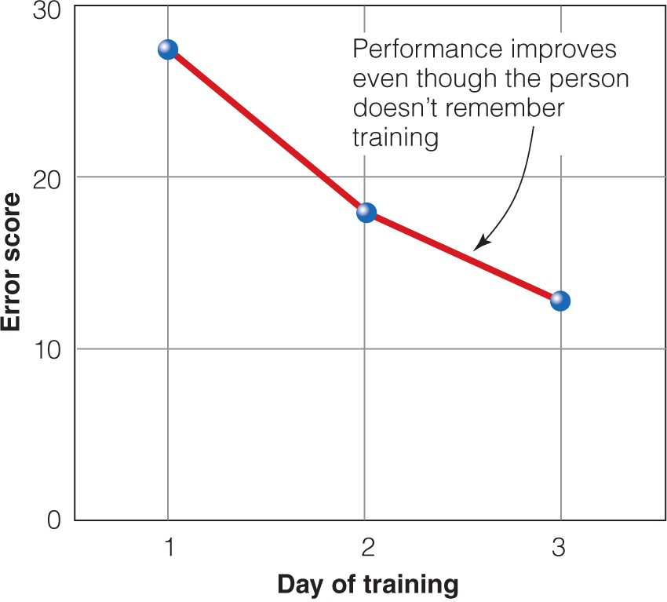
Implicit Memory and Amnesia
Warrington and Weiskrantz (1968):
Notes:
Indeed over the course of the three days of training the amnesiacs became better at naming the line drawings. That is, the number of errors that they made decreased.
This would impossible if they did not encode some new memories during training. Yet, the patients could not remember what occurred on the prior days – or even 15 minutes ago.
This indicates that new memories were encoded, but the amnesic patients were unable to retrieve them. However, their behavior was affected by the training.

Slide 9
Memory Activity: Test
Unscramble these words:
NBCHE NOCR PENHO
BSHU CCLEY
SENTIN SPARPEN LURAJON BATLE EPICRUT
Notes:
What I’d like you to now is solve these anagrams. That is, these words are scrambled up. Unscramble them to form the words. How are you doing? Are you getting most of these?

Slide 10
Memory Activity: Answers
Events are the basis of learning and knowledge affects are future experiences.
Unscramble these words: Remember these words:
NBCHE NOCR PENHO BSHU CCLEY
SENTIN SPARPEN LURAJON BATLE EPICRUT
bench bush journal table picture
Notes:
You may have noticed that some of these words were easier to unscramble than others.
That’s because the words in red were primed on the third slide of this lecture.

Slide 11
Study Guide 1
True or False? Sometimes memory is impacted by factors out of our control.
True
False

Slide 12
Study Guide 1
True or False? Sometimes memory is impacted by factors out of our control.
True
False

Slide 13
Study Guide 2
True or False? Declarative memories are memories for events or knowledge about the world.
True
False

Slide 14
Study Guide 2
True or False? Declarative memories are memories for events or knowledge about the world.
True
False

Slide 15
Study Guide 3
True or False? Implicit memory is when a recent event needlessly impacts your behavior without your awareness.
True
False

Slide 16
Study Guide 3
True or False? Implicit memory is when a recent event needlessly impacts your behavior without your awareness.
True
False

Slide 17
Study Guide 4
True or False? Implicit memory effects diminish more rapidly than memory for past events.
True
False

Slide 18
Study Guide 4
True or False? Implicit memory effects diminish more rapidly than memory for past events.
True
False

Slide 19
Study Guide 5
True or False? Unlike normal individuals, amnesiacs are immune to implicit effects.
True
False

Slide 20
Study Guide 5
True or False? Unlike normal individuals, amnesiacs are immune to implicit effects.
True
False

