Slide 1
COGNITIVE PSYCHOLOGY
Kenneth J. Malmberg, PhD

Slide 2
ICONIC AND ECHOIC MEMORY
Kenneth J. Malmberg, PhD
Notes:
In our lectures on perception, we discussed over and over again the fact that our experiences of the present are not a direct reflection of our environment. Rather, our experience is based on a mental representation of our environment.

Slide 3
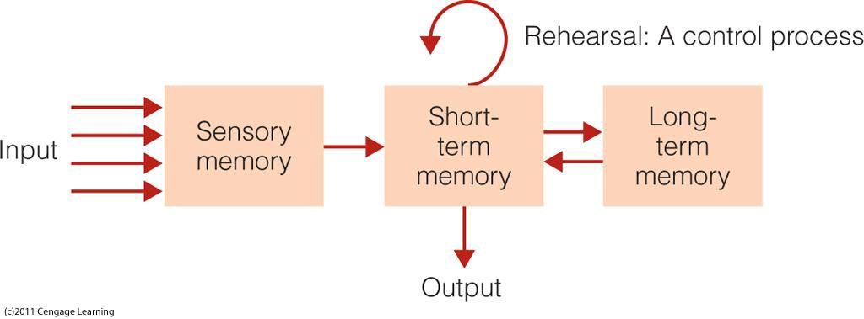
The Modal Model
The Modal Model - Atkinson & Shiffrin (1968)
Structures: Invariant properties of memory
Sensory Memory: holds all incoming information for seconds or fractions of seconds
Short-term Memory (STM): limited capacity, holds information for 15-30 seconds
Long-term Memory (LTM): holds large amount of information perhaps permanently
Notes:
When we talk about a representation of the environment we need to make some things that are obvious more explicit.
First, the representation is temporary, which is good because our environment can change quickly.
Second, whenever one talks about a representation we must address the medium for this representation: Where is it? What is it?
According to the modal model, sensory memory is where these brief representations are stored. There is a sensory memory associated with all of our senses. Here we will focus on two of them: Iconic and echoic memory.
These were terms given by Neisser to the sensory memory structures associated with vision and hearing, respectively.

Slide 4
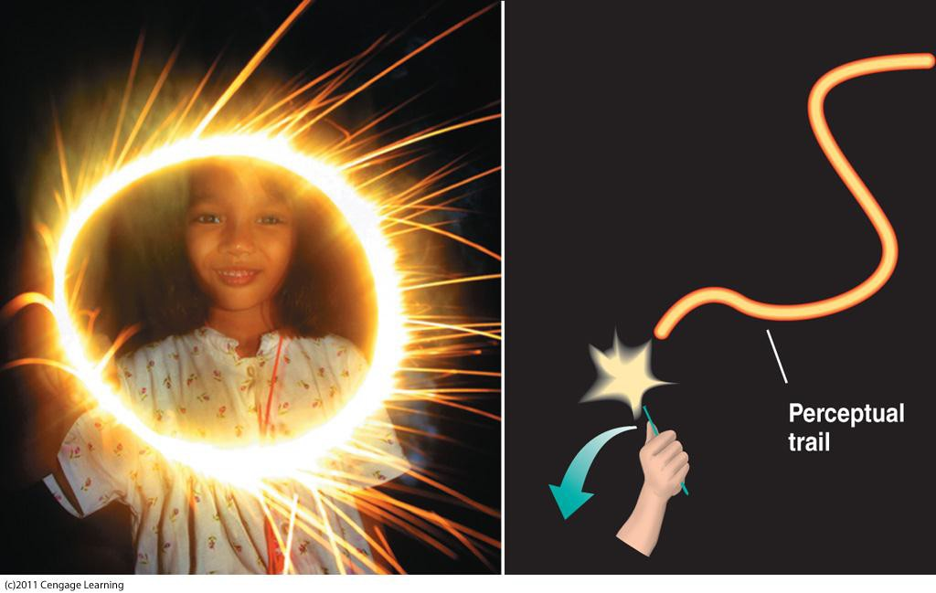
Sensory Memory
Notes:
Iconic memory is something we all are aware of from a very early age. It is what produces the trails of light that we see as an iconic image of the world decays.

Slide 5
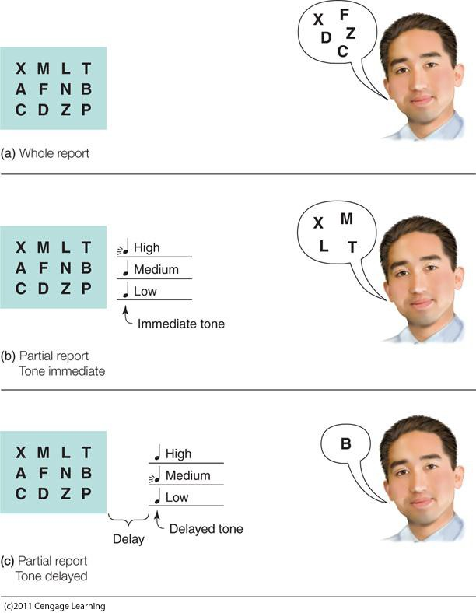
Sperling’s Work on Sensory Memory
Sperling (1960)
Briefly flash arrays of letters
Follow with a mask
Cue memory with a tone
IV: Vary the number of letters
DV: number of letters reported
Notes:
In several classical experiments, Sperling investigated two properties of iconic memory.
First, he was interested in the capacity of iconic memory. That is, he wanted to know how much information could be represented.
Second, he was interested in the duration of iconic memory. Once represented in iconic memory, how long does that information persist before it is lost?
To address the first question concerning capacity, he briefly flashed an array of letters followed by a mask. The array consisted of three rows of letters. The subjects task was recall the letters in the array.

Slide 6
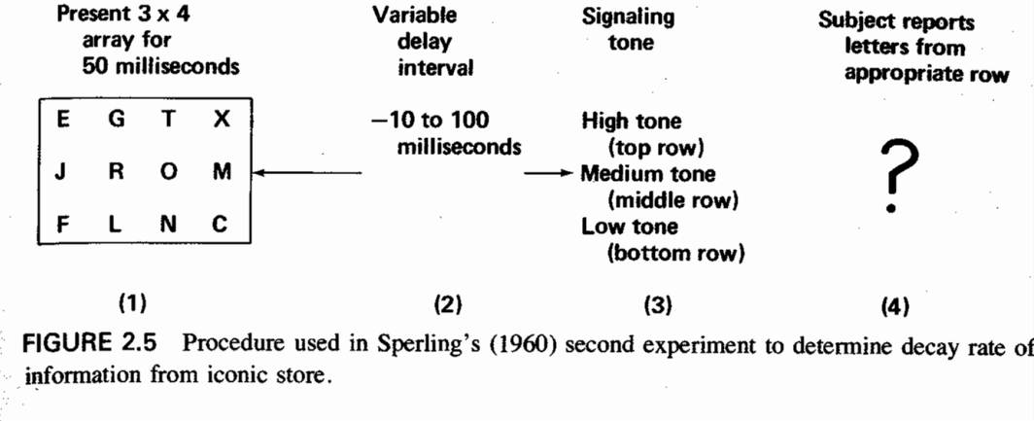
Sperling’s Work: Critical Manipulation
Full Report: Report all the Items
Partial Report: Report only items from a specific row
Notes:
To address the question of the duration of iconic memory, he prompted or cued subjects to recall after various delays or retention intervals following the mask.
There were two recall procedure used by Sperling. The first is known as a full report procedure, whereby subjects were simply cued to recall all of the items from the array.
This procedure had been used for decades, and it produced consistent results; subjects were able to recall only four or five of the letters. Researchers concluded that the capacity of iconic memory was only 4 or 5 items.
But this didn’t make sense to Sperling, and he came up an ingenious way testing the conventional wisdom. The partial report procedure cued subjects to recall the letters only from one row the array.

Slide 7
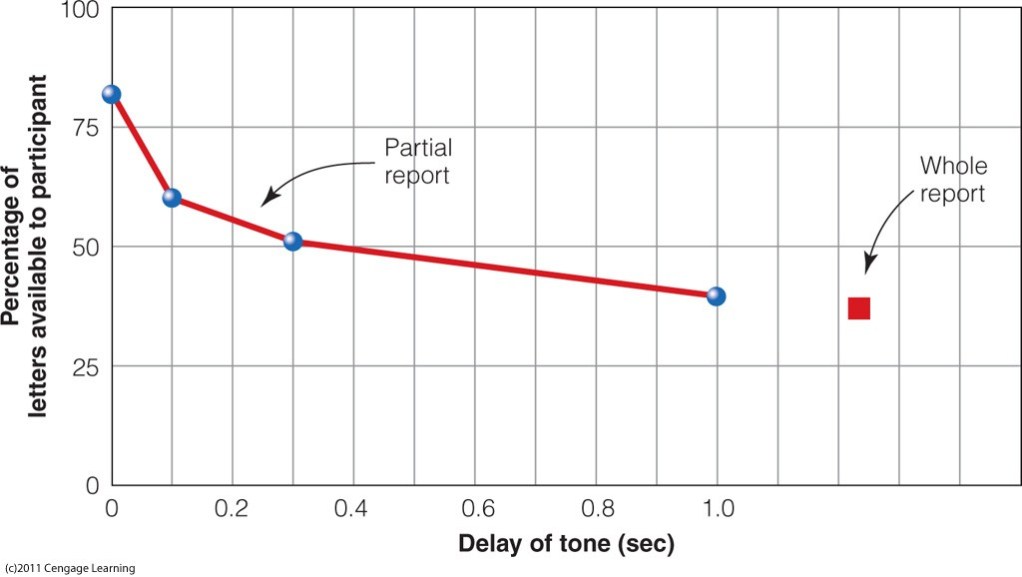
Sperling’s Work: Findings
Full Report: Report all the Items
Partial Report: Report only items from a specific row
After a delay subjects report approximately the same number letters in both tasks.
Notes:
Sperling found two important things.
Regardless of whether the full report or the partial report procedure was used, subjects only recall 4 or 5 letters. This suggests that actually the capacity of iconic memory is very, very large. For if 4 or 5 items from any row could be recalled, then at least 4 or 5 items must have been represented at some point.
The reason only 4 or 5 items could be reported is because the information in iconic memory decays very quickly, in far less than 1 s.

Slide 8
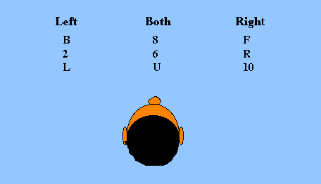
Echoic Memory
Darwin, Turvey & Crowder (1972)
Notes:
A similar experiment was conducted by Darwin, Turvey, & Crowder to investigate the capacity and duration of echoic memory. In this experiment, spatial arrays of letters and numbers were presented to subjects over headphones.
Some items were presented in the right channel, some items were presented in the left channel, and some items were presented in both channels.
Those presented in both channels sounded like they can from straight ahead of the subject.

Slide 9
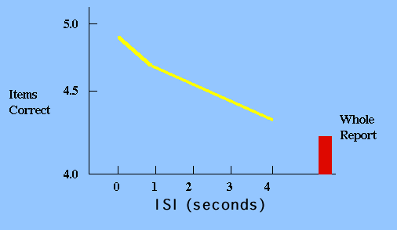
Echoic Memory: Findings
Darwin, Turvey & Crowder (1972) Results
Notes:
Just as in the Sperling experiments, both full and partial report procedures were used. Concerning the capacity of the echoic memory the results were the same. The amount recalled was same in both procedures suggesting that echoic memory had a very large capacity.

Slide 10
Iconic vs. Echoic Memory: Compare
Compare these Results:
?
What is the major difference between iconic and echoic memory? Why is there a difference?
Notes:
However the results were different when Darwin looked at the persistence of echoic memory, which decayed a much slower rate than iconic memory. Whereas iconic memory decays in less than a second, echoic memory decays in about 4 seconds.
We can see this by comparing the x axis of these two figures.
Why might this be the case?
Well, it turns out that visual information is usually stationary. From one instance to the next it remains in front of us. It makes sense that we wouldn’t have to represent it for a very long time. On the other hand, echoic memory is used to represent auditory information. Once a sound is made, it’s gone. In order to put together the sounds for a word or sentence, these sounds need to be represented for a longer period of time.

Slide 11
Study Guide 1
True or False? Sensory memory is where brief representations of our environment are stored.
True
False

Slide 12
Study Guide 1
True or False? Sensory memory is where brief representations of our environment are stored.
True
False

Slide 13
Study Guide 2
True or False? Iconic memory is place where auditory information is briefly held and echoic memory is where visual information is briefly held.
True
False

Slide 14
Study Guide 2
True or False? Iconic memory is place where auditory information is briefly held and echoic memory is where visual information is briefly held.
True
False

Slide 15
Study Guide 3
True or False? Sperling was interested in the capacity of iconic memory.
True
False

Slide 16
Study Guide 3
True or False? Sperling was interested in the capacity of iconic memory.
True
False

Slide 17
Study Guide 4
True or False? The full report procedure produces an inaccurate measure of the capacity of sensory memory
True
False

Slide 18
Study Guide 4
True or False? The full report procedure produces an inaccurate measure of the capacity of sensory memory
True
False

