Slide 1
COGNITIVE PSYCHOLOGY
Kenneth J. Malmberg, PhD

Slide 2
FLASHBULB MEMORIES
Kenneth J. Malmberg, PhD
Notes:
In this section of the course, we have seen over and over again that memory fails us. Indeed, it fails us in systematic and therefore predictable ways.
On the other hand, memory often seems to be highly accurate, especially for events that evoke powerful emotion, as the Scientific American Frontiers episode showed. But are these memories really more accurate?

Slide 3
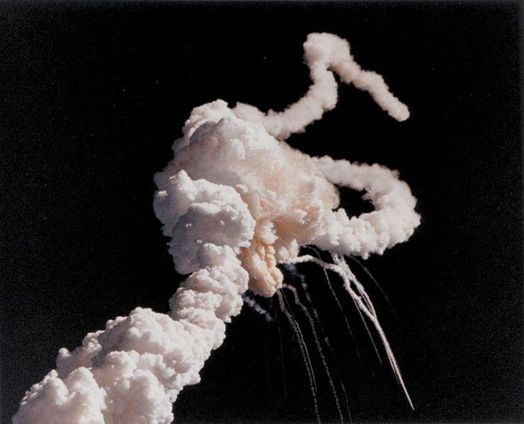
Flashbulb Memory: Challenger Tragedy
Autobiographical Memories
Recollected events that belong to a person’s past.
Challenger Disaster
Notes:
Almost every American born before 1990 remembers what occurred on 9/11/2001. I recall stopping at gas station to buy some cigarettes on my way to the lab, and there being a TV on behind the counter with images of something that looked like a volcano erupting.
I paid little more attention to this until I got to the Psychology building and saw TV set had wheeled in the main office and the internet was virtually shutdown.
Memories such as these are often referred to as Flashbulb Memories.
I also remember where I was when the space shuttle Challenger exploded in 1986. I was an undergraduate at the University of Illinois, and I had decided to skip class and instead to go to Doc J’s for a hot dog across the street from the Psychology Building.
I remember watching a TV in the corner of the room as the launch took place and thinking to myself “that doesn’t usually happen”.

Slide 4
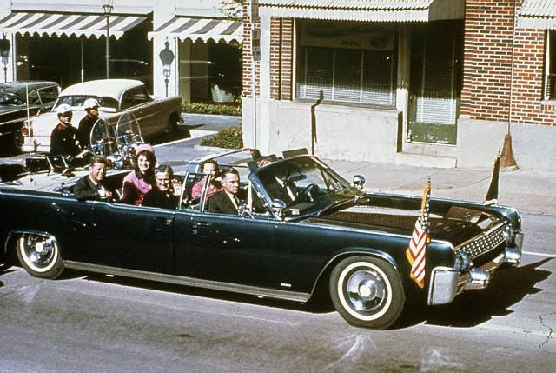
Flashbulb Memory: JFK Tragedy
Autobiographical Memories
Recollected events that belong to a person’s past.
Challenger Disaster
JFK Assassination
Notes:
The people from my mother’s generation have vivid memories of where they were when they learned of JFK being assassinated.

Slide 5
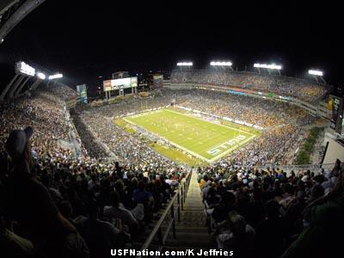
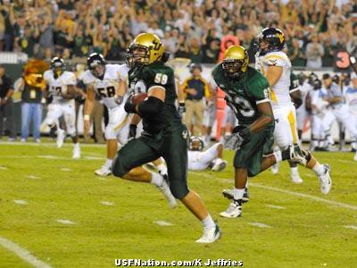
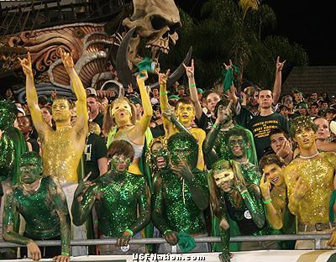
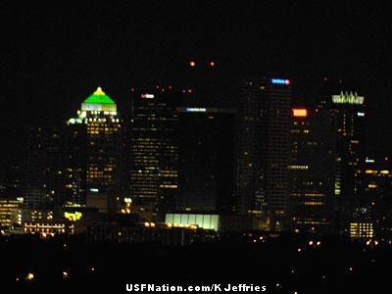
Flashbulb Memory: Happy Events
Autobiographical Memories
Recollected events that belong to a person’s past.
Challenger Disaster
JFK Assassination
USF beats WV!!!!
Notes:
I will also never forget where I was when USF beat West Virginia a few seasons ago.

Slide 6
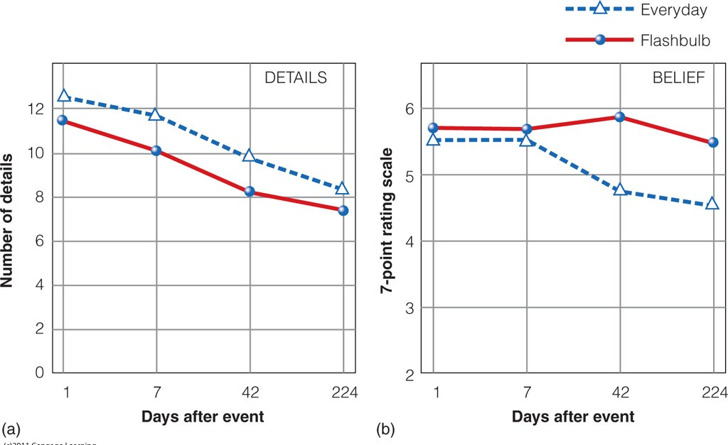
Flashbulb Memory and Confidence
Flashbulb Memories: Talarico and Rubin (2003)
Notes:
Events that evoke strong emotions seem to be remembered more accurately than everyday events. The idea behind a flashbulb memory being that events are remembered so well, it as if a flash bulb went off and took a photograph of the event as it occurred.
This implies that flashbulb memories should be highly accurate and very resistant to fading. It turns out, however, that these flashbulb memories are just as susceptible to error as other memories.
Here are the results of study conducted by Talarico and Rubin just after 9/11. The study compares the memories of everyday things to those of what happened on 9/11. As you can see there is virtually no difference in the number of details that are recalled.
Thus, it appears that flashbulb memories are no more vivid than everyday memories. Moreover, both memories are forgotten at about the same rate.
What does differentiate flashbulb and everyday memories is the confidence that we have in them. People are much more confident in the accuracy of flashbulb memories than everyday memories.

Slide 7
Study Guide 1
True or False? A flashbulb memory is one for an event that provokes a powerful emotional reaction.
True
False

Slide 8
Study Guide 1
True or False? A flashbulb memory is one for an event that provokes a powerful emotional reaction.
True
False

Slide 9
Study Guide 2
True or False? Flashbulb memories are more accurate than everyday memories.
True
False

Slide 10
Study Guide 2
True or False? Flashbulb memories are more accurate than everyday memories.
True
False

Slide 11
Study Guide 3
True or False? People tend to be highly confident in their memories for emotional events.
True
False

Slide 12
Study Guide 3
True or False? People tend to be highly confident in their memories for emotional events.
True
False

