Slide 1
COGNITIVE PSYCHOLOGY
Kenneth J. Malmberg, PhD

Slide 2
EYEWITNESS MEMORY
Kenneth J. Malmberg, PhD
Notes:
If flashbulb memories are not necessarily very accurate, should we believe the testimony of eyewitnesses? This is a tricky question. As in any other type of retrieval, memories appear to be constructed from information representing what actually happened plus additional factors that did not actually happen.

Slide 3
Memory Errors and Culture
Bartlett’s “War of the Ghosts” Experiment
Participants increasingly forgot aspects of the story as the retention interval increased.
The reproductions were shorter.
The errors tended to reflect the participants own culture and the culture described in the story.
Notes:
Since, encoding is incomplete and error prone, the challenge for retrieval is to make sense of the information that was stored. This too can be thought of as an inferential process. That is one might try to infer what happened based on the partial information that is available.
The idea that remembering involves the retrieval of information about what actually occurred and information that one might reasonably expect might have occurred is referred to as reconstruction.
Bartlett’s “War of the Ghosts” Study is perhaps the most well-known investigation of reconstructed memory.
In this study, subjects in England were read a story about a tribe in a jungle who took a canoe trip up river to wage war on another tribe. At various retention intervals, their memory of the story was tested.
The results showed that:
Participants in the UK increasingly forgot aspects of the story as the retention interval increased.
The reproductions were shorter as the retention interval increased.
But perhaps most interestingly, the errors tended to reflect the participants own culture and the culture described in the story. That is, the subjects’ version of what occurred changed in peculiar manner. It began to reflect their world view more and more.
For instance, the subject began to report that tribe took a “ship” upriver, which is consistent with the sort of transportation that they might take up river, rather than a canoe that is more common in other cultures.

Slide 4
Constructed Memories and Bias
Constructed Memories: recollected events are constructed by the person based on what actually happened plus additional factors that did not actually happen.
Educated Guesses about High School Grades
Bahrick et al., 1996
A : 89%
D : 29%
79 out of 99 students inflated their grades by remembering some of them as being higher than what they really were.
Notes:
Bartlett’s study suggests that when retrieving memory, we actually attempt to interpret contents of memory based on what typically occurs. We also seem to be biased to remember events in way that presents ourselves in a favorable light.
Here are the results of a study by Bahrick . He obtained the high school records of his students. He then compared the grades that subjects actually received in high school with the grades that subject reported that they received.
79 out of 99 students inflated their grades by remembering some of them as being higher than what they really were.

Slide 5
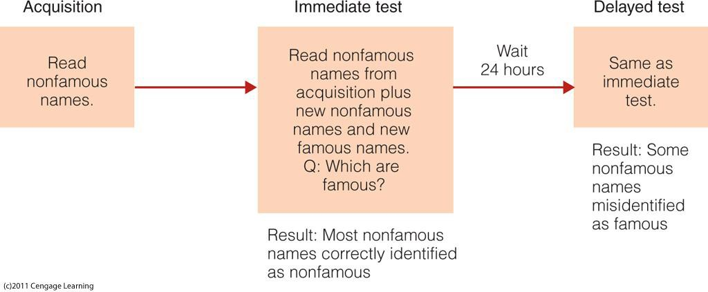
Source Monitoring
Source Monitoring: Jacoby et al. (1989)
Notes:
In eyewitness memory it is often important to remember where and when something occurred. People also have a terrible time remembering where they received information. Memory for where, when, or from whom is often referred to as Source Memory.
This was explored by Jacoby. In this experiment, subjects first read a list of names randomly selected from a telephone book, after which subjects were shown some of these names as well as some names of famous people.
The subjects’ task was simple. Determine which names are famous and which names are not famous. Subjects were very good at identifying the famous names.
When their memory was again tested 24 hours later, the subjects began to identify the names that were randomly selected from the phonebook as being famous names.
Jacoby proposed that this is because they knew they had heard the name before, but they forgot where they heard it.

Slide 6
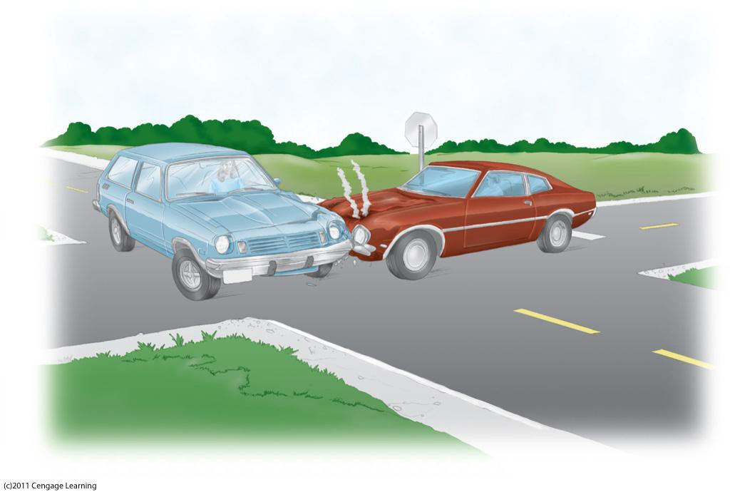
Suggestibility and Memory
Memory Can Be Modified or Created by Suggestion
Misleading Post event Information (MPI): information presented after a memory traces has been stored that alters its contents.
“hit”: 34 mph
“smashed”: 43 mph
Notes:
We began by asking whether or not we should trust eyewitness testimony. Given all these results, it is probably not surprising to you that memory for a crime or tragic event can be altered.
In this experiment conducted by Loftus, subjects viewed a videotape of a car accident. Later their memory for the accident was tested.
Some subjects were asked to estimate how fast the car was going when it “hit” the other car.
The other subjects were asked to estimate how fast the car was going when it “smashed” into the other car.
Subjects who were asked how fast the car was going when it smashed into the other car estimated its speed to be almost 25% faster than those who were asked how fast the car was going when it hit the other car.

Slide 7
Eyewitness Testimony
Watch CBS 60 Minutes Videos Eyewitness Testimony Part 1 and Part 2”
Notes:
You can watch a youtube video entitled “Heroin in the Heartland, Le Carré” available in this module to learn more about this concept.

Slide 8
Study Guide 1
True or False? Eyewitness testimony is most often used to convicted people of a crime.
True
False

Slide 9
Study Guide 1
True or False? Eyewitness testimony is most often used to convicted people of a crime.
True
False

Slide 10
Study Guide 2
True or False? Over time, details are lost from memory, but other than that the content is not altered.
True
False

Slide 11
Study Guide 2
True or False? Over time, details are lost from memory, but other than that the content is not altered.
True
False

Slide 12
Study Guide 3
True or False? Source memory is memory for where or when something occurred.
True
False

Slide 13
Study Guide 3
True or False? Source memory is memory for where or when something occurred.
True
False

Slide 14
Study Guide 4
True or False? According to Gary Wells on the 60 Minutes segment, simultaneous lineups enhance the accuracy of convictions.
True
False

Slide 15
Study Guide 4
True or False? According to Gary Wells on the 60 Minutes segment, simultaneous lineups enhance the accuracy of convictions.
True
False

Slide 16
Study Guide 5
True or False? Memories change overtime, but are not susceptible to our own biases.
True
False

Slide 17
Study Guide 5
True or False? Memories change overtime, but are not susceptible to our own biases.
True
False

