Slide 1
COGNITIVE PSYCHOLOGY
Kenneth J. Malmberg, PhD

Slide 2
PERCEPTION HEURISTICS
Kenneth J. Malmberg, PhD
Notes:
One of the big ideas in this course is that mind has a remarkable capacity for effectively dealing with sparse information. Rarely is it the case that we have all the information needed to completely represent a given situations. For this reason, the mind often relies on heuristics.
A heuristic can be thought of as a rule or some or default decision. They are particularly useful when one has incomplete information.

Slide 3
Heuristics and Perception
Heuristics for Perceiving
Occlusion Heuristic: When a large object is partially covered by smaller occluding object, we see the larger one as continuing behind the smaller occluder.
Notes:
This is even the case visual perception, where the Occlusion Heuristic plays an important role in our representation of the world.

Slide 4
Occlusion
Heuristics for Perceiving
Occlusion Heuristic: When a large object is partially covered by smaller occluding object, we see the larger one as continuing behind the smaller occluder.
oc·clude
Pronunciation: \ə-ˈklüd, ä-\ Function: verb
Inflected Form(s): oc·clud·ed; oc·clud·ing
Etymology: Latin occludere, from ob- in the way + claudere to shut, close — more at close
Date: 1597
transitive verb 1: to close up or block off : obstruct <a thrombus occluding a coronary artery>; also : conceal
Notes:
The word occlusion is related to the word occlude, which means to close up or block off.
As is often the case, we must make sense of world in which the objects in our environment are partially occluded.

Slide 5
Occlusion Example
Heuristics for Perceiving
Occlusion Heuristic: When a large object is partially covered by smaller occluding object, we see the larger one as continuing behind the smaller occluder.
Notes:
The occlusion heuristic states that when a large object is partially covered by smaller occluding object, we see the larger one as continuing behind the smaller occluder.
Note here that without the grey object serving as the occluder, it is very difficult that blue area consists of three capitol Bs. In this case, the remarkable thing is that perception is actually aided by the occluder.

Slide 6
Lighting Heuristic
Heuristics for Perceiving
Light-from-Above Heuristic: We assume that light comes from above
Notes:
A heuristic that is critically important for depth perception is the Light-from-Above Heuristic. It states that we assume that light comes from above. In doing so, we make inferences about where shadows should be given certain sorts of objects. If we have a concave object, like the dimple on a golf ball, then the light from above should cast a shadow on the top of the object. If we have a convex object, like a pimple, then light from above should cause a shadow on the bottom of the object.

Slide 7
Lighting Heuristic Example
Heuristics for Perceiving
Light-from-Above Heuristic: We assume that light comes from above
Notes:
The influence of the light from above heuristic can be appreciated when viewing these two photos. They look like completely different landscapes, but they are actually the same. One is simple upside down cause the shadows to fall upward instead of downward. Here the light-from-above heuristic is making it very difficult to notice that they are same objects.

Slide 8
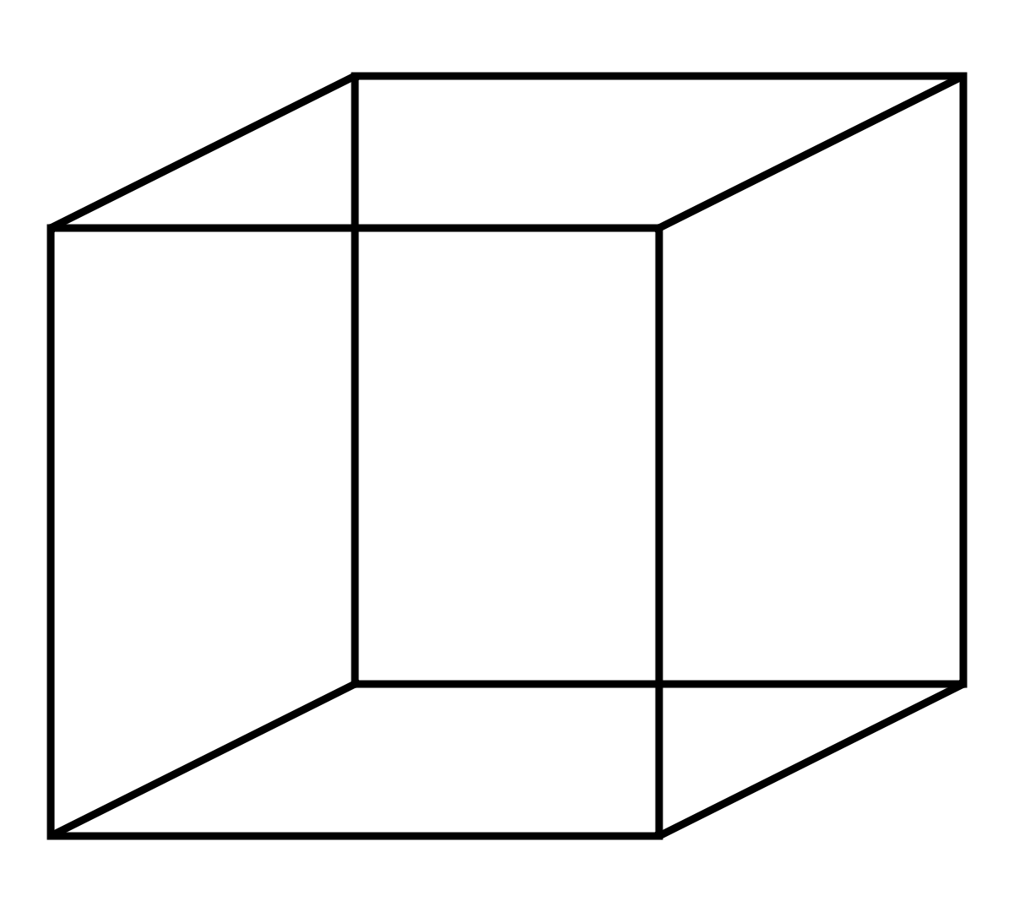
Perceptual Ambiguity
For a variety of reasons, it would be useful to create machines that can see.
What do we mean by “see”?
Notes:
Many researchers are working on developing machines that can see, but this discussion should cause us to ask what we mean by “to see”.

Slide 9
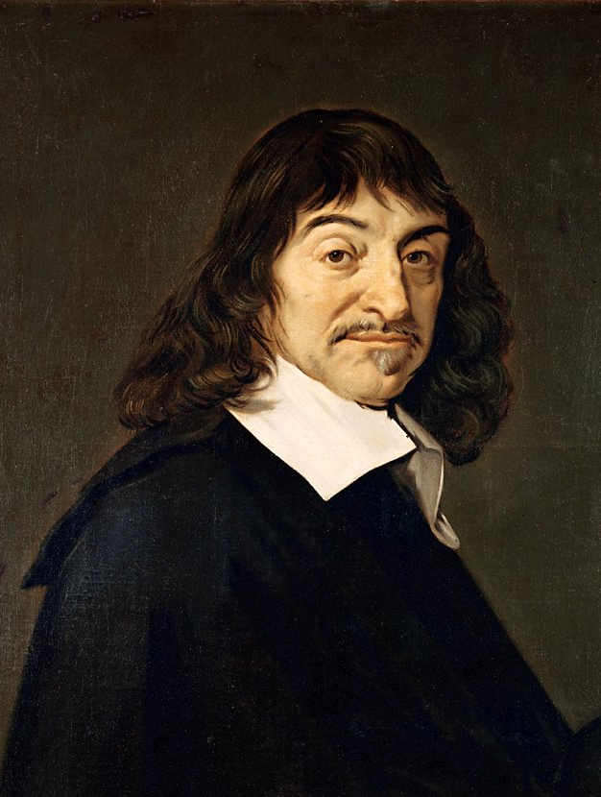
Descartes and Representation
?
Remember this guy?
Big Idea: The sensory receptors translate information from the environment into a neural or mental representation.
Therefore, we do not necessarily experience directly our world. Rather, we experience our own mental representations of the world.
Cogito ergo sum – R. Descartes
René Descartes
Notes:
Remember this guy? He proposed that we do not really perceive what is in our environment. That is, we experience an internal representation of the environment that may or may not be accurate.

Slide 10
Perceptual Ambiguity Example
Why does something that is so easy, like looking at a scene and seeing what is out there, become so complicated when we look at the mechanisms involved?
What we perceive is influenced by both the sensations that we receive from the environment and the knowledge that we have about the world.
Notes:
It like after having a few of these…things may begin to look different to you.

Slide 11
What do you see?
Notes:
So the key thing to remember is that perceptual systems are designed to make sense of out of ambiguous information.
Take for example, this line drawing. Can you tell what it is?
Ah yes, many of you see a martini glass. But that is only because I just should you picture of martini glass.

Slide 12
How about now?
Why does something that is so easy, like looking at a scene and seeing what is out there, become so complicated when we look at the mechanisms involved?
What we perceive is influenced by both the sensations that we receive from the environment and the knowledge that we have about the world.
Notes:
If I had shown you think picture instead, you may have said that the ambiguous object was actually a set of bikini bottoms.

Slide 13
Ambiguity and Illusion
Shepard’s Bikini-Martini Illusion
Notes:
This is known as the Bikini-martini illusion.

Slide 14
Knowledge Informs Perception
Why does something that is so easy, like looking at a scene and seeing what is out there, become so complicated when we look at the mechanisms involved?
What we perceive is influenced by both the sensations that we receive from the environment and the knowledge that we have about the world.
Notes:
The fact that it works indicates that what we perceive is influenced by both the sensations that we receive from the environment and the knowledge that we have about the world.

Slide 15
Sensation and Knowledge
Why does something that is so easy, like looking at a scene and seeing what is out there, become so complicated when we look at the mechanisms involved?
What we perceive is influenced by both the sensations that we receive from the environment and the knowledge that we have about the world.
Notes:
Processing information that we receive from the world in order to identify an object is known as bottom-up processing, and use of our knowledge about the world to identify an object is known as top-down processing. In general, our experience is mixture of both bottom-up and two-down processing.

Slide 16
Scene Knowledge and Object Recognition
Why does something that is so easy, like looking at a scene and seeing what is out there, become so complicated when we look at the mechanisms involved?
What we perceive is influenced by both the sensations that we receive from the environment and the knowledge that we have about the world.
Notes:
Here is an example.
In this experiment, subjects were briefly shown this scene. After it was removed from sight subjects were asked to report the objects in the scene.

Slide 17
Scene and Object Recognition - Results
Why does something that is so easy, like looking at a scene and seeing what is out there, become so complicated when we look at the mechanisms involved?
What we perceive is influenced by both the sensations that we receive from the environment and the knowledge that we have about the world.
83%
40%
50%
Notes:
Of course, all subject recognized the scene as kitchen. But what was important was the type of objects that were reported as having been in the scene. For instance, 83% reported see the loaf of bread, even though it was not there, whereas only 40% reported seeing a mailbox. Thus, subjects inferred the presence of the bread simply because they recognized the scene as a kitchen as bread if often found in kitchens.

Slide 18
Study Guide 1
True or False? The mind uses heuristics to interpret ambiguous perceptual information.
True
False

Slide 19
Study Guide 1
True or False? The mind uses heuristics to interpret ambiguous perceptual information.
True
False

Slide 20
Study Guide 2
True or False? Heuristics are always correct.
True
False

Slide 21
Study Guide 2
True or False? Heuristics are always correct.
True
False

Slide 22
Study Guide 3
True or False? Helmhotlz would have disagreed with the occlusion heuristic.
True
False

Slide 23
Study Guide 3
True or False? Helmhotlz would have disagreed with the occlusion heuristic.
True
False

Slide 24
Study Guide 4
True or False? Heuristics are a way for general knowledge about the world to aid perception.
True
False

Slide 25
Study Guide 4
True or False? Heuristics are a way for general knowledge about the world to aid perception.
True
False

Slide 26
Study Guide 5
True or False? Heuristics influence our internal representation of the environment.
True
False

Slide 27
Study Guide 5
True or False? Heuristics influence our internal representation of the environment.
True
False

