Slide 1
COGNITIVE PSYCHOLOGY
Kenneth J. Malmberg, PhD

Slide 2
NEURONS
Kenneth J. Malmberg, PhD
Notes:
Hello. In this lecture, we will discuss how the brain supports cognition.
The big idea in this lecture is that normal everyday craziness that we experience begins at very first stage of information processing in the brain.

Slide 3
Cognition and the Brain
?
How do neurons process information?
Notes:
So let’s start at the beginning and discuss how neurons work.

Slide 4
Cognition and the Brain - Who Cares?
?
How do neurons process information?
!
Who cares? This is a class on Cognitive Psychology, not Neuroscience!
Notes:
If you are like me, your initial response to this question is “Who cares?”
However, it turns out that this is a really interesting question.

Slide 5
Cognition and the Brain: Relationships
?
How do neurons process information?
!
Who cares? This is a class on Cognitive Psychology, not Neuroscience!
Many years ago, the distinction between cognitive psychology and neuroscience was dramatic. Cognitive psychologists and neuroscientists did not interact much.
Today, each discipline falls under the umbrella of Cognitive Science, and the goal is to better understand how the brain gives rise to the mind (or mental experience) and how the mind is used to think and how it allows us to interact effectively in our environment.
Thus, our understanding of the brain constrains our models of the mind, and our understanding of behavior constrains our models of the brain.
Notes:
And it is critical for answering one of the most important questions in all of science.
What is that question you ask?
The key question concerns the relationships between the brain, the mind, and behavior. Indeed, at the turn of the new millennium, scientists voted this to be the second most important question, following only the origin of the universe.
As cognitive psychologists, we have historically been primarily interested in the second half of this equation. Specifically, we have been focused for the past 60 years or so on figuring out the nature of the mind by observing behavior.
However, during that time, neuroscientists have discovered many important things about how the brain works. In fact, theories derived from cognitive research often predicted the discoveries made by neuroscientists.
That relationship has now become a two-way street. Theories of the brain often inform theories of the mind, and vive versa. This is what we call interdisciplinary approach to understanding. In fact, many of the hottest new ideas about the relationship between the mind and the brain come from other fields, such as artificial intelligence, and statistics. This interdisciplinary field is known as Cognitive Science.
Thus, our understanding of the brain constrains our models of the mind, and our understanding of behavior constrains our models of the brain.
And since brains function as the result of the interactions of billions of neurons, it is important to understand neurons.

Slide 6
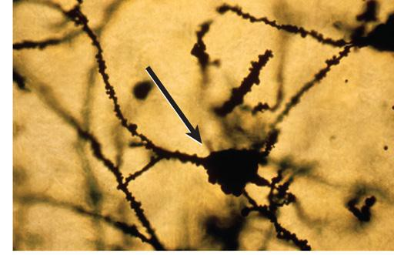
Neuron Image
?
How do neurons process information?
NEURON
Neurons are cells that receive and transmit information.
A Neuron Image
Notes:
From the perspective of cognitive psychologists, neurons are cells that receive and transmit information.

Slide 7
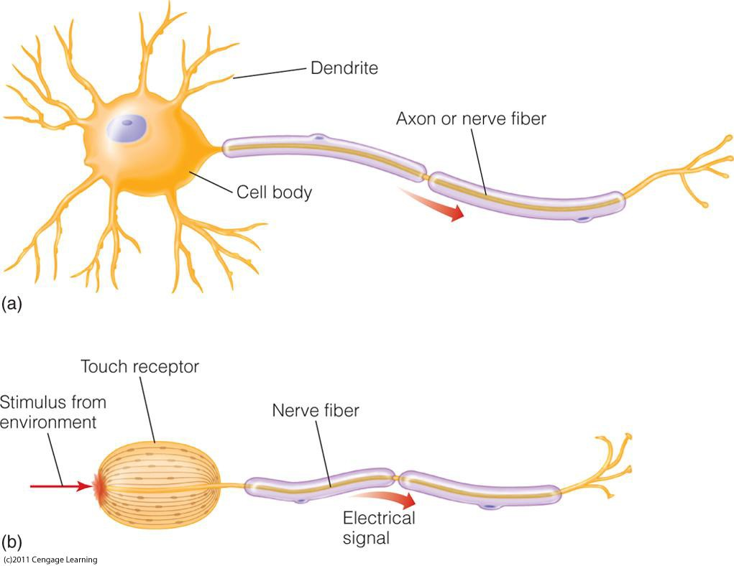
Neuron Structure
Notes:
The figure at the top shows a typical neuron.
Notice that the neuron consists of several different parts.

Slide 8
Dendrites
Notes:
The smaller spikey areas of the neuron are called dendrites. These receive information from other neurons.

Slide 9
Axons
Notes:
The longer projection of the neuron are called axons, and these transmit information to other neurons.
The information transmitted between neurons is in the form of electro-chemical energy.
They’re actually little electrical circuits.

Slide 10
Transduction
Notes:
The neuron on the bottom is a special type of neuron, called a sensory neuron.
It does not receive information from the axon of another neuron but from the environment.
Thus, the form of this information is different.
It’s in the form of physical energy. For instance let us assume that is a sensory receptor associated with vision.
Photons of light landing on the receptors of the eye stimulate this receptor.
Sensory receptors convert this physical energy to electrical energy.
So here is one of the big ideas.
From the very first stage of information processing, our brain is transforming our environment into a representation of it.
And this representation, is the result of translating a physical stimulus into an electrochemical representation of it.
This process is known as transduction.
There are sensory receptors associated with all five senses.

Slide 11
Single Cell Recordings
SINGLE CELL RECORDINGS
Recording from single neurons: “single cell recordings.”
The goal is to detect the signals produced by a single neuron. By doing so in presence of different stimuli, we can infer to what that neuron responds most vigorously and hence how it contributes to cognition.
Notes:
So one question we may ask is how neurons respond to changes in the environment or other stimuli.
One way to address this question is to take recordings of the activity of single cells.
The goal is to detect the signals produced by a single neuron.

Slide 12
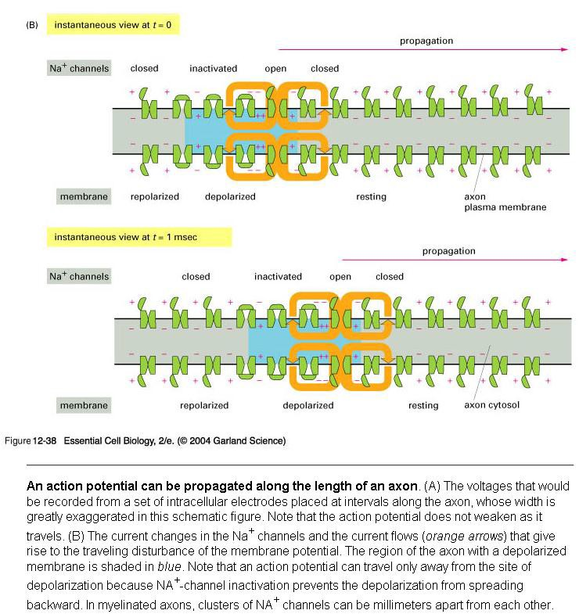
Action Potentials
ACTION POTENTIALS
Recording from single neurons: “single cell recordings.”
These signals are referred to as Action Potentials.
Action potentials are changes in the electrical charge of a neuron along its axon.
Notes:
These signals are known as Action Potentials. The form of the action potential is a change in the electro-chemical charge of the neuron. When such a change occurs the neuron is said to “fire”.
In its normal state, the inside of the axon is negatively charged.
When one patch of cell membrane is depolarized enough to open its voltage-gated sodium channels, positively-charged sodium ions enter the cell.
Once inside, sodium ions "nudge" adjacent ions down the axon and attract negative ions away from the adjacent membrane.
Once the adjacent patch of membrane is depolarized, the voltage-gated sodium channels in that patch open, regenerating the cycle. The process repeats itself down the length of the axon.
As a result, a wave of positivity moves down the axon without any individual ion moving very far.
This is known as propagation.

Slide 13
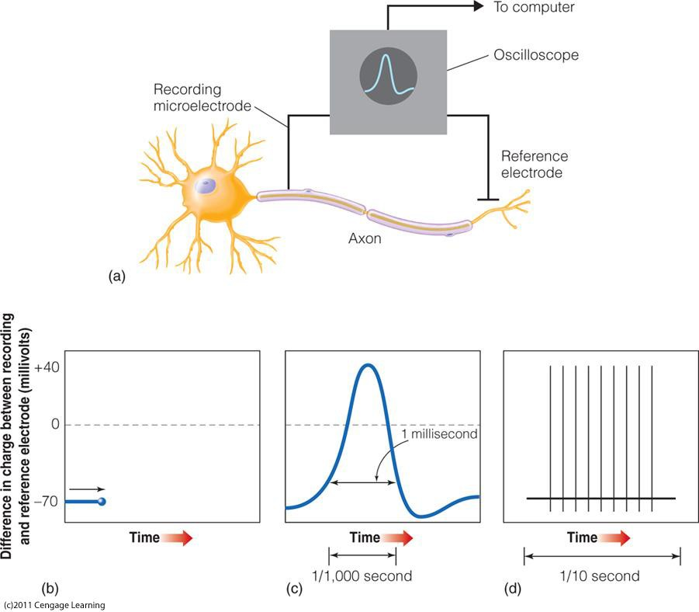
Action Potentials: Measurement
Recording from single neurons: “single cell recordings.” These signals are referred to as Action Potentials.
A Single Action Potential
Notes:
To make individual cell recordings an oscilloscope is used.
What this diagram shows is that it takes about 1 ms for a neuron to go from negatively charged to positive charged and back.
In other words it takes about 1 ms for a neuron to fire.
This is referred to as an action potential.

Slide 14
Action Potentials: Firing Rates
All action potentials have the same size.
However, neurons respond to different stimuli in the rate at which the action potential responds.
These action potentials are propagated along the axon.
A Series of Action Potentials
Notes:
This diagram also shows that a neuron may actually fire many times in response to a stimulus.
The greater a stimulus activates a neuron the more times it fires.
This is known as its firing rate.
Note each action potential is of the same magnitude.
Hence, the firing rate, not its magnitude, is the measure of how active a neuron is.

Slide 15
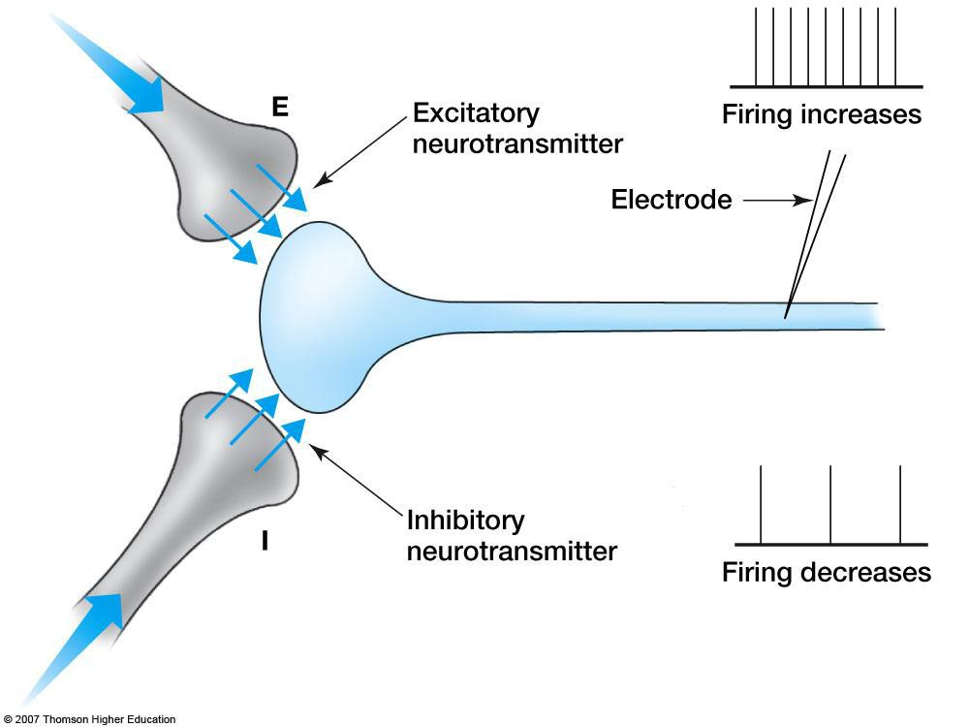
Synapses
!
Communication between neurons occurs at a synapse.
When the action potential arrives at the end of the axon, it triggers a chemical process that bridges the gaps between neurons by releasing neurotransmitters.
These gaps are synapses.
Notes:
This slide shows what happens where two neurons meet.
Actually they do not physically meet, but something occurs in the gap between the axon of one neuron and the dendrite of another neuron.
This gap is called a synapse.
Messages are sent in the form a release of neurotransmitters into the synapse.
There are two types of messages that can be conveyed from one neuron to another.
The message can be excitatory, in which case the sending neuron is encouraging the receiving neuron to fire.
Or the message can be inhibitory, in which case the sending neuron is discouraging the receiving neuron to fire.
The firing rate is determined by the difference in the amount of excitatory versus inhibitory neurotransmitters that are released.

Slide 16
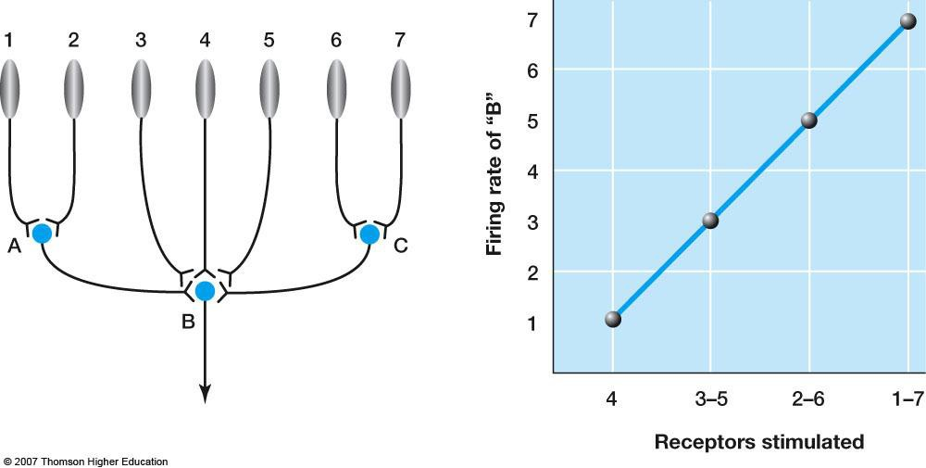
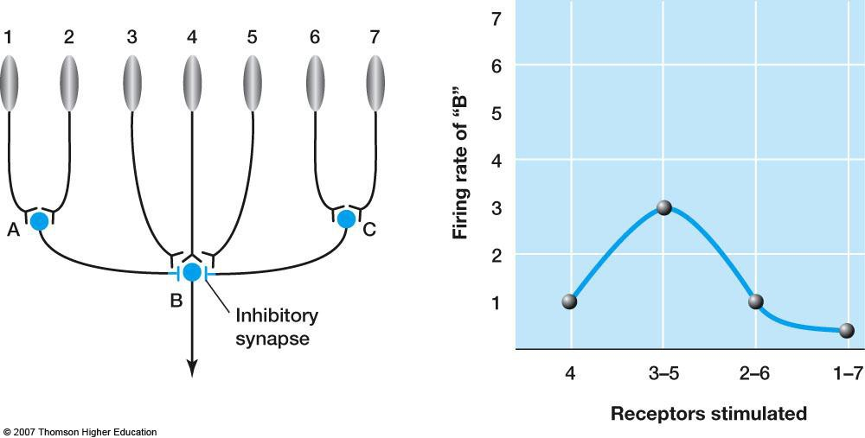
Interacting Neurons
!
Neurons process information by interacting with each other.
All excitatory synapses
Notes:
This slide shows how this difference is computed.
Here we have two different scenarios.
In both scenarios, we have two neurons synapsing on neuron A, five neurons synapsing on neuron B, and two neurons synapsing on neurons C.
Two of the synapses on neuron B comes from neurons A and C.
In the top scenario, all synapse on B are excitatory, whereas in the bottom scenario the synapses from and A and C are inhibitory.
The figures on the right plot the firing rate of B as a function which receptors are activated. In the top scenario the synapses are excitatory.
so the more receptors that are activated the greater firing rate of B.
In the bottom scenario, when the receptors synapsing on A and C are activated the firing rate of B is depressed.

Slide 17
Study Guide 1
True or False? Studying the working of neurons helps us understand the relationship between the brain and mind.
True
False

Slide 18
Study Guide 1
True or False? Studying the working of neurons helps us understand the relationship between the brain and mind.
True
False

Slide 19
Study Guide 2
True or False? Typical neurons send to and receive information from each other.
True
False

Slide 20
Study Guide 2
True or False? Typical neurons send to and receive information from each other.
True
False

Slide 21
Study Guide 3
True or False? Transduction is the transfer of information from one neuron to another.
True
False

Slide 22
Study Guide 3
True or False? Transduction is the transfer of information from one neuron to another.
True
False

Slide 23
Study Guide 4
True or False? Neural activity is measured by the magnitude of its firing.
True
False

Slide 24
Study Guide 4
True or False? Neural activity is measured by the magnitude of its firing.
True
False

Slide 25
Study Guide 5
True or False? The combination of excitatory and inhibitory neurotransmitters released into the synapse determines the level firing in the receiving neuron.
True
False

Slide 26
Study Guide 5
True or False? The combination of excitatory and inhibitory neurotransmitters released into the synapse determines the level firing in the receiving neuron.
True
False

