Slide 1
COGNITIVE PSYCHOLOGY
Kenneth J. Malmberg, PhD

Slide 2
GESTALT
Kenneth J. Malmberg, PhD
Notes:
Hi. Welcome back.
Over the past few lectures, we have begun looking at the working of the mind, and how the fact that our indirect experience of the world is based on our own representation of the world leads to some of the everyday craziness we all experience.
However, perhaps some of you were not impressed with the Necker cube or the Müller-Lyer illusion. This one is for you.

Slide 3
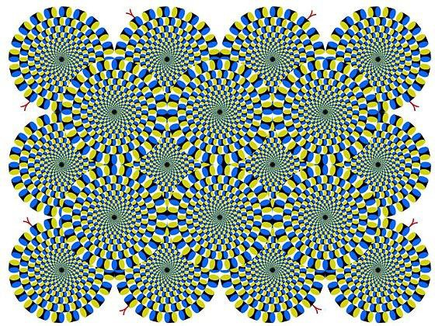
Illusory Motion
Notes:
Anyone see the “wheels” turning?
Of course, they’re not. This is all happening in your head. But what if you had encountered this display on a webpage outside of the context of this course? Would you have accepted as a fact the motion that you experienced? Yes, you would have. If asked to report what you saw, like an eyewitness, would you have reported motion? Probably. Would you be wrong? Yes.
Let explore visual perception a little bit more.

Slide 4
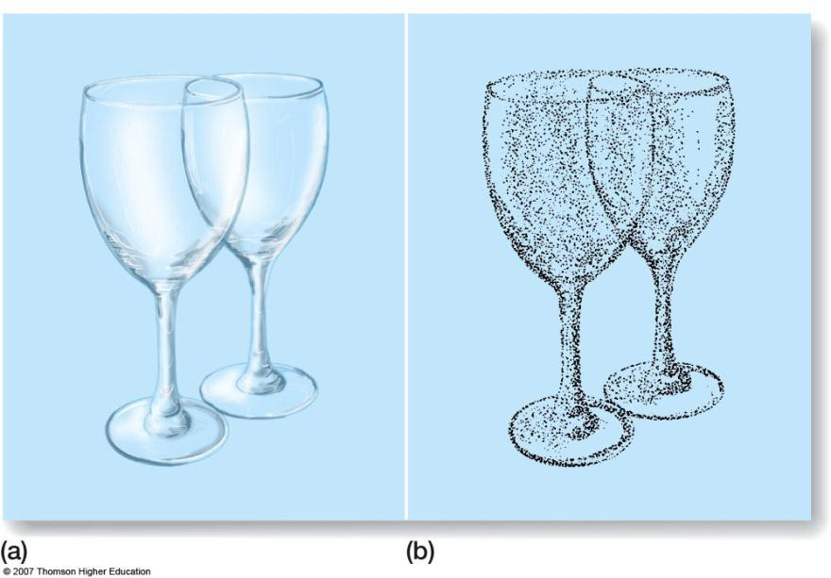
Perceptual Organization and Structuralism
Perceptual organization: the organization of elements of the environment into objects
Each dot represents a sensation
According to the structuralists, this pattern of sensations results in us perceiving two wine glasses.
Contrast the structuralist approach to the Gestalt approach which emphasizes the overall pattern of the stimulus.
Notes:
You will remember from our last lecture that visual processing initially detects very primitive line segments, curves, and the orientations. Higher level visual processing then reconstructs a representation of the environment by putting these elements back together. Here we are going to look at theories for how this is accomplished.
The Gestalt school is one of the most influential sources of theory in cognitive psychology. Whereas the structuralist school focused on the sensations, how they were related, and how they may be combined, the Gestalists emphasize patterns or perception of the whole.
Consider these two wine glasses.
According to the structuralists, this pattern of sensations results in us perceiving two wine glasses. That is, rules for combining individual sensation dictate the outcome.
Contrast the structuralist approach to the Gestalt approach which emphasizes the overall pattern of the stimulus.

Slide 5
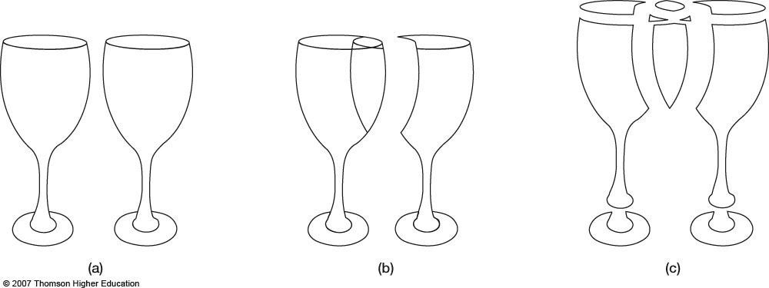
Laws of Perceptual Organization
Perceptual organization: the organization of elements of the environment into objects
Gestalt psychologists recognized that the objects could be perceived in a number of different ways. The “whole” is greater than the sum of the “parts”. “Emergent properties”.
The fact that we perceive them easily as two wine glasses reflects the laws of perceptual organization.
Notes:
Gestalt psychologists recognized that the objects could be perceived in a number of different ways. The “whole” is greater than the sum of the “parts”. That is, the stimulus is necessarily ambiguous but gives rise to “Emergent properties”. The fact that we perceive them easily as two wine glasses reflects the laws of perceptual organization.

Slide 6
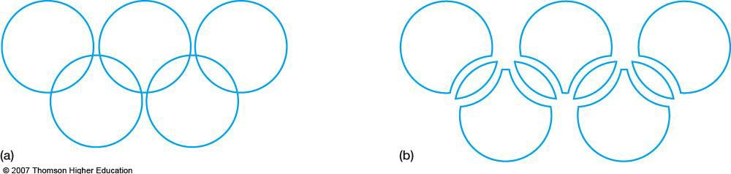
Laws of Simplicity: Example 1
Gestalt psychologists recognized that the objects could be perceived in a number of different ways.
The fact that we perceive them easily as two wine glasses reflects the laws of perceptual organization.
Law of Simplicity (Pragnanz): Every stimulus pattern is seen in such a way that the resulting structure is as simple as possible.
Notes:
Gestalt psychologists described several laws of perceptual organization.
Law of Simplicity (Pragnanz): Every stimulus pattern is seen in such a way that the resulting structure is as simple as possible.
It is easy to recognize this as the Olympic rings. But also notice that there is more than one way to perceive it. The simplest way, that is the way based on the fewest number of contributing elements, is to view the stimulus as five rings.

Slide 7

Laws of Simplicity: Example 2
Gestalt psychologists recognized that the objects could be perceived in a number of different ways.
The fact that we perceive them easily as two wine glasses reflects the laws of perceptual organization.
Law of Simplicity (Pragnanz): Every stimulus pattern is seen in such a way that the resulting structure is as simple as possible.
This figure appears to the eye as a square overlapping triangle, not a combination of several complicated shapes.
Notes:
Here is another example of Pragnanz.
The above figure appears to the eye as a square overlapping triangle, not a combination of several complicated shapes.

Slide 8
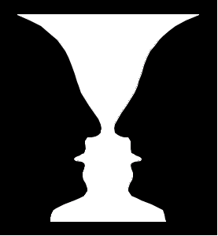
Laws of Simplicity: Example 3
Gestalt psychologists recognized that the objects could be perceived in a number of different ways.
The fact that we perceive them easily as two wine glasses reflects the laws of perceptual organization.
Law of Simplicity (Pragnanz): Every stimulus pattern is seen in such a way that the resulting structure is as simple as possible.
Notes:
Again most people initially perceive this stimulus as a white vase on a black background. However, it could also be perceived as two black profiles on a white background. The later representation is based on a more complicated computation, however.

Slide 9

Laws of Simplicity: Example 4
Gestalt psychologists recognized that the objects could be perceived in a number of different ways.
The fact that we perceive them easily as two wine glasses reflects the laws of perceptual organization.
Law of Simplicity (Pragnanz): Every stimulus pattern is seen in such a way that the resulting structure is as simple as possible.
Notes:
Here is an example from marketing. This logo developed for Norway when they hosted the Winter Olympics. The outstretched arms are immediately apparent welcoming visitors. Upon closer inspection, other aspects of the country that the marketers want to convey also are revealed, namely the mountains, forests, and oceans.

Slide 10
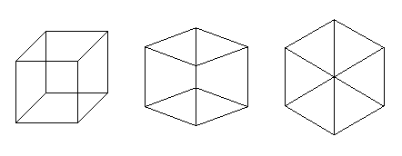
Laws of Simplicity: Example 5
Law of Simplicity (Pragnanz): Every stimulus pattern is seen in such a way that the resulting structure is as simple as possible.
Look at the patterns above. All are perfectly good drawings of a cube, but the one on the left looks three-dimensional, the one on the right looks like a flat wedge pattern. We see the left pattern as a 3d cube because it is simpler to understand it that way, than to see it as a flat pattern of triangles and quadrilaterals. Similarly, we see the right pattern as flat because it is simpler to see it that way, than to think of it as a cube turned on end.
Notes:
Here is our friend the Necker cube again.
All are perfectly good drawings of a cube, but the only the one on the left looks three-dimensional, the one on the right looks like a flat wedge pattern. We see the left pattern as a 3D cube because it is simpler to understand it that way than to see it as a flat pattern of triangles and quadrilaterals. Similarly, we see the right pattern as flat because it is simpler to see it that way, than to think of it as a cube turned on end.

Slide 11
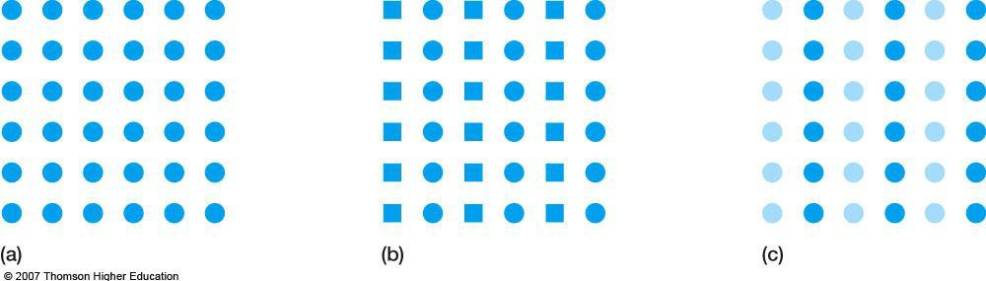
Law of Similarity
Gestalt psychologists recognized that the objects could be perceived in a number of different ways.
The fact that we perceive them easily as two wine glasses reflects the laws of perceptual organization.
Law of Similarity: Similar things appear to be grouped together.
Notes:
Law of Similarity: Similar things appear to be grouped together.
All the panels are the same, except for the objects that comprise columns. When different objects comprise different columns, the square area is more easily perceived as a series of columns.

Slide 12

Law of Good Continuation: Example 1
Law of Good Continuation: Point that, when connected, result in straight or smoothly curving lines tend to be seen as following the smoothest path.
Notes:
Law of Good Continuation: Points that, when connected, result in straight or smoothly curving lines, are seen as belonging together, and the lines tend to be seen as following the smoothest path.
This display could be perceived as a large number of objects lying adjacent to each other. However, it seems that the Law of Good Continuation is applied to see a single string like object on a blue background.

Slide 13
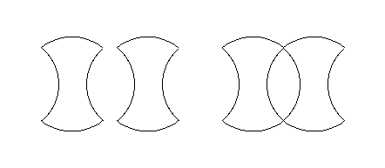
Law of Good Continuation: Example 2
Law of Good Continuation: Points that, when connected, result in straight or smoothly curving lines, are seen as belonging together, and the lines tend to be seen as following the smoothest path.
Two objects touching now appear to be one object
Notes:
The line making up these two displays are exactly the same. However, when they touch, the Law of Good Continuation can be applied to perceive to pacman objects instead of two apple cores.

Slide 14
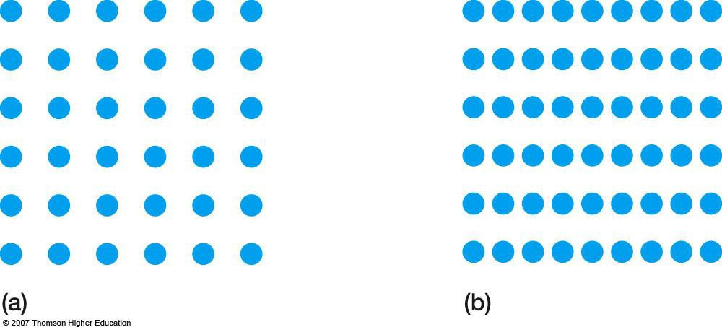
Law of Proximity
Gestalt psychologists recognized that the objects could be perceived in a number of different ways.
The fact that we perceive them easily as two wine glasses reflects the laws of perceptual organization.
Law of Proximity: Things that are near to each other appear to be grouped together.
Notes:
This slide illustrates the Law of Proximity: Things that are near to each other appear to be grouped together.

Slide 15
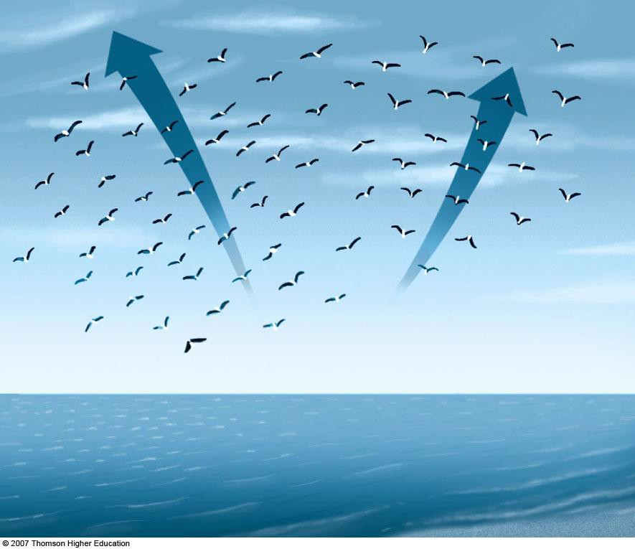
Law of Common Fate
Gestalt psychologists recognized that the objects could be perceived in a number of different ways.
The fact that we perceive them easily as two wine glasses reflects the laws of perceptual organization.
Law of Common Fate: Things that are moving in the same direction appear to be grouped together.
Notes:
Remember that there are visual processing areas of the brain devoted to detecting motion. Gestalt laws also apply to motion. Namely, the Law of Common Fate: Things that are moving in the same direction appear to be grouped together.

Slide 16
Study Guide 1
True or False?
A key problem with the structuralist approach to perception is that the same stimulus may give rise to different experiences.
True
False

Slide 17
Study Guide 1
True or False?
A key problem with the structuralist approach to perception is that the same stimulus may give rise to different experiences.
True
False

Slide 18
Study Guide 2
True or False?
The Law of Simplicity states that the stimulus is perceived in the least complex way.
True
False

Slide 19
Study Guide 2
True or False?
The Law of Simplicity states that the stimulus is perceived in the least complex way.
True
False

Slide 20
Study Guide 3
True or False?
The Gestalts believed that the sum is greater than its emergent properties.
True
False

Slide 21
Study Guide 3
True or False?
The Gestalts believed that the sum is greater than its emergent properties.
True
False

Slide 22
Study Guide 4
True or False?
The Law of Similarity states that similar things are more easily perceived.
True
False

Slide 23
Study Guide 4
True or False?
The Law of Similarity states that similar things are more easily perceived.
True
False

Slide 24
Study Guide 5
True or False?
The Law of Proximity states that things near to each tend to be grouped together.
True
False

Slide 25
Study Guide 5
True or False?
The Law of Proximity states that things near to each tend to be grouped together.
True
False

