Slide 1
COGNITIVE PSYCHOLOGY
Kenneth J. Malmberg, PhD

Slide 2
BRAIN AREAS
Kenneth J. Malmberg, PhD
Notes:
In the past section, we looked at how neurons transmit information.
In this section, we look at the role of different brain areas in cognition.
Many of you are familiar with phrenology.
A key assumption of phrenologists was that different areas of the brain were associated with different aptitudes.
The phrenologists also believed that size of the brain areas was indicative of an individual’s particular level of a certain aptitude.
Last, phrenologists thought that the areas of the brain could be measure by inspecting the scalp of a subject with one’s hands.
It turns out that the phrenologists were correct about all but the last assumption.

Slide 3
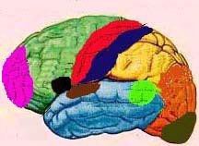
Brain Function Localization
Cognitive processes and the brain
The brain is organized into different brain areas. Each is responsible for an aspect of cognition.
Cortical Area
Primary Motor Cortex
Primary Somatosensory Cortex Prefrontal Cortex
Motor Association Cortex Speech Center (Broca's Area) Auditory Cortex
Auditory Association Area Visual Association Area Visual Cortex
Wernicke's Area
Function
Initiation of voluntary movement Receives tactile information Planning, emotion, judgment Coordination of complex movements Speech production and articulation Auditory perception and hearing Complex processing of audition Complex processing of vision Primary visual perception Comprehension of spoken language
Notes:
The right side of this slide shows in different colors the different areas of the brain.
The left side of this side lists the names of these areas and role they play.
The color of the font corresponds to the color of shaded in areas in the figure on the right.
For, instance the olive colored area towards the back of the brain is the primary visual cortex.
Here we are looking at the outside of the brain. It is the part of the brain that has evolved most recently. For this reason it is called the neocortex.
Notice how much of this part of the human neocortex is devoted to planning, language, and sight.
Not surprisingly, humans are very visual animals that are uniquely gifted in high order thought and language.
The middle of the brain contains the most primitive brain structures, such as the hippocampus and the amygdala.
These areas are responsible for learning, memory, and emotion and are well developed in lower level species such as rats, pigeons, and cats.

Slide 4
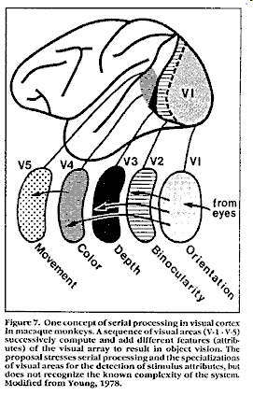
Visual Brain Areas
Notes:
Let’s take a closer look at the part of the brain involved in processing visual information.
Note in this figure that several areas of the brain are involved in vision.
Strangely enough, visual information is initially processed in the very back of the brain or the posterior parts of the brain.
The area of the brain involved in initial visual processing is known as V1, and it detects the orientation of different lines or curves associated with a stimulus.
Processing then proceeds forward to increasingly anterior brain regions.
In V2, V3, V4, and V5, the representations of lines and curves are put together, depth and color is added and movement is represented.
Notice that these more complex processes take place near to the area of the neocortex responsible for planning and judgment.

Slide 5
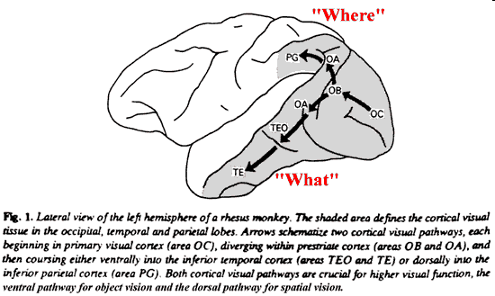
Dorsal and Ventral Streams
Notes:
Also note that there two pathways through visual processing.
There are essentially two things we need to know about an object that we see.
We need to know where it is and we need to know what it is.
The path migrating long the top of the brain is the dorsal path, as in dorsal fin. It processes the location of the object.
The ventral path migrates along the bottom of the brain, and it is responsible for identifying the object.
The critical things to note are that:
The brain did not evolve randomly. Areas of the brain that are responsible for processing similar information are nearer to each other.
B) The brain processes information in a very systematic way.

Slide 6
Face Processing
Fusiform Face Area (FFA)
The FFA contains many neurons that respond robustly to faces.
PROSOPAGNOSIA
Prosopagnosia, or face-blindness, is a neurological condition that renders a person incapable of recognizing faces. It is unrelated to the person's ability to see faces. Someone with perfect vision can suffer from prosopagnosia. It is also unrelated to the person's IQ.
Watch the video entitled “Is That My Brother? Perceptual and Neurobiological”
Notes:
A particularly interesting area of the brain in the ventral visual pathway is known as the Fusiform Gyrus or the Fusiform face area.
It the part of the brain devoted to identifying faces.
We know this because people who have damage to this area of the brain are unable to identify faces.
They can identify everything else just fine. They are unable to identify faces, even those of close friends and family members.
This condition is called Prosopagnosia.
In the Brain Area section of Blackboard links to videos that show you people with Prosopagnosia. They are very interesting, and I encourage to take a look at them.
You can watch a youtube video entitled “Is That My Brother? Perceptual and Neurobiological” available in this module to learn more about this concept.

Slide 7
Prosopagnosia
Subtypes of prosopagnosia
Apperceptive prosopagnosia is thought to be a disorder of some of the earliest processes in the face perception system. People with this disorder cannot make any sense of faces and are unable to make same-different judgments when they are presented with pictures of different faces.
Associative prosopagnosia is thought to be an impairment to the links between early face perception processes and the semantic information we hold about people in our memories. People with this form of the disorder may be able to say whether photos of people's faces are the same or different and derive the age and gender from a face but may not be able to subsequently identify the person or provide any information about them such as their name, occupation or when they were last encountered.
Developmental prosopagnosia is thought to be a form of 'congenital prosopagnosia', and that some people are born with a selective impairment in recognizing and perceiving faces. The cases that have been reported suggest that this form of the disorder may be highly variable and there is some suggestion that it may be hereditary.
Notes:
Let’s think about this more carefully by considering what we already know about the brain.
First, face recognition involves visual processing; so we would expect to find the Fusiform Face Area in one of the two vision processing pathways.
It requires the identification of faces, and therefore it is not surprising that the fusiform face area is located near the ventral pathway.
Last, the ability to recognize faces is present even in lower level animals. For instance, your pet probably recognizes everyone in your household.
Thus, the fusiform face area is located toward the middle of the brain near the hippocampus.

Slide 8
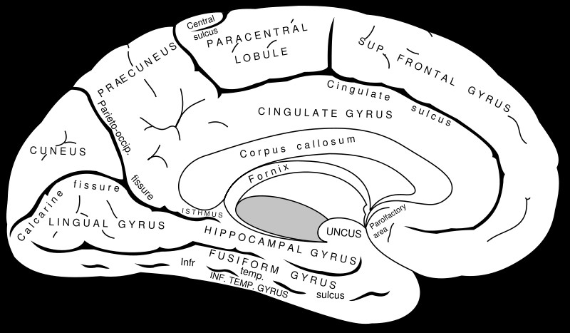
Face Perception and the Brain
Fusiform Face Area (FFA) The FFA contains many neurons that respond robustly to faces.
Notes:
Researchers have learned a lot about the roles of different brain areas by studying the behavior of people with brain damage.
Dissociations are phenomena in which one brain function is implicated in the performance of certain task but another is not. They are used to determine what function different regions of the brain perform.

Slide 9
Dissociation
Dissociations: These are situations in which one brain function is implicated but another is not. They are used to determine what function different regions of the brain perform.
Notes:
Some rather remarkable dissociations have been documented.
For instance, you are all familiar with the distinction between short-term versus long-term memory, and researchers looking to test this distinction were able to identify an important dissociation between subjects who had damage to the frontal versus the temporal lobes of the brain.
Patients with frontal lobe damage are impaired in short-term memory but not long-term memory, whereas patients with temporal lobe damage have the reverse condition.

Slide 10
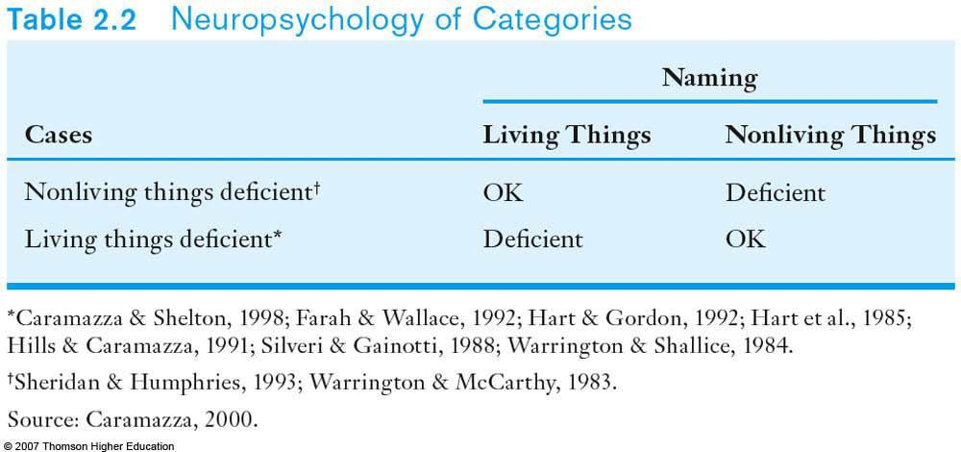
Dissociation and the Brain Function
Dissociations: these are situations in which one brain function is implicated but another is not. They are used to determine what function different regions of the brain perform.
Notes:
For instance, some people are able to name living objects but are unable to name inanimate objects.
Others have the reverse condition.
People with Prosopagnosia can identify all objects except for faces.

Slide 11
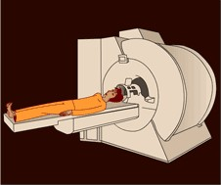
Brain Imaging Technology
Cognitive processes are signaled by many different brain areas. Each area contributes something.
Brain Imaging Positron Emission Tomography (PET) Functional Magnetic Resonance Imaging (fMRI)
Notes:
Another way researcher investigate what different areas of the brain do is to use brain imaging technology.
PET and fMRI are most common.
They both measure what is known as BOLD, Blood Oxygen Level Difference.
The key assumption is that brain areas that are very active require more oxygen to operate.
Thus, PET and fMRI measure the amount of blood flow in regions of the brain.
Interestingly, both technologies use methods very similar to Donders subtraction method.

Slide 12
Brain Imaging Technology and the Subtraction Method
Cognitive processes are signaled by many different brain areas. Each area contributes something.
Brain Imaging Positron Emission Tomography (PET) Functional Magnetic Resonance Imaging (fMRI)
Subtraction Method: Subtract the activation of the brain in a control condition from a different condition in which everything is same except one thing. The remaining activation implicates the area of the brain responsible for performing that one other thing. (Blood Oxygen Level Difference: BOLD)
Notes:
Here is an example.

Slide 13
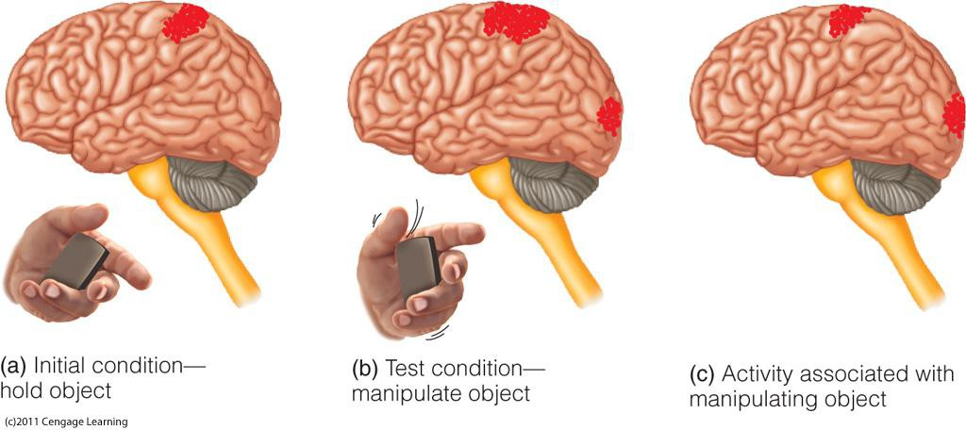
Subtracting Brain Activity
Subtraction Method: Subtract the activation of the brain in a control condition from a different condition in which everything is same except one thing. The remaining activation implicates the area of the brain responsible for performing that one other thing. (Blood Oxygen Level Difference: BOLD)
Notes:
There are two conditions, in a typical brain imaging experiment. In the control condition, the brain activity is recorded while the subject is at rest or is performing a simple task.
This is illustrated in panel A, which shows a small brain activity in the dorsal area of the brain.
In the experimental condition, the stimulus may be presented or the subject may perform a slightly more complicated task than in the control condition.
Again, the brain activity is recorded.
In order to identify the portion of the brain responsible for processing the stimulus in the experimental condition or to identify the more complicates aspect of the task,
the brain activity in the control condition is subtracted from the brain activity in the experimental condition.
Here we see in Panel C, that the visual cortex and another dorsal area of the brain was responsible for processing the stimulus in the experimental condition of this experiment.

Slide 14
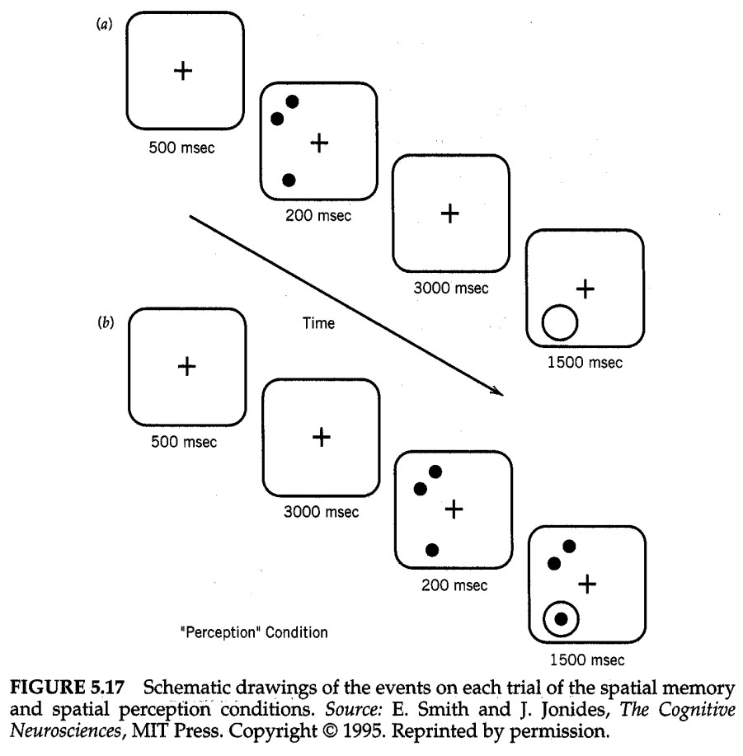
Working Memory: Control Condition
The Neural Basis of Working Memory
Positron emission tomography (PET)
Smith and Jonides (1995)
IV: memory + spatial task vs. spatial-only task
DV: PET activation
Notes:
Lets look at a real-world example from a paper by Smith and Jonides.
These researchers were interested in what part of the brain was responsible for spatial memory. That is, they were interested in the part of the brain is responsible for remembering where something is.
What we see in the figure depicts two conditions of this experiment. In each condition there were four displays presented to the subject, one at a time for various lengths of time.
The circles displays are what was presented in the control condition.
First, a fixation cross was present for 500 ms and it remained displayed for an additional 3000 ms. Fixation crosses are shown to the subject simply to direct their attention to the middle of the display.
Next, three dots were briefly displayed for 200 ms.
Last, a circle appeared, and the subject had to respond yes if a dot appeared in the circle or no if a dot did not appear in the circle.
Notice in the control condition the subject did not have to remember where the dots were.

Slide 15
Working Memory: Experimental Condition
The Neural Basis of Working Memory
Positron emission tomography (PET)
Smith and Jonides (1995)
IV: memory + spatial task vs. spatial-only task
DV: PET activation
Notes:
Everything was the same in the experimental condition except the middle two displays were reversed, and subjects was to respond yes if a dot appeared in the second display in the same location as the circle or no if a dot did not appear in the circle. Thus, using the subtraction method, Smith and Jonides were able locate the area of the brain responsible for spatial memory.

Slide 16
Working Memory: Conclusions
The Neural Basis of Working Memory
Positron emission tomography (PET)
Smith and Jonides (1995)
IV: memory + spatial task vs. spatial-only task
DV: PET activation
Results: Enhanced activation in the right prefrontal cortex near area 46 for the memory + spatial task
Conclusions: The right prefrontal cortex is involved in spatial memory.
Notes:
Results: Enhanced activation in the right prefrontal cortex near area 46.
Conclusions: The right prefrontal cortex is involved in spatial memory.

Slide 17
Study Guide 1
True or False? Sophisticated advances in brain imaging technology refute all of theoretical assumptions of Phrenology.
True
False

Slide 18
Study Guide 1
True or False? Sophisticated advances in brain imaging technology refute all of theoretical assumptions of Phrenology.
True
False

Slide 19
Study Guide 2
True or False? Different areas of the brain perform different tasks.
True
False

Slide 20
Study Guide 2
True or False? Different areas of the brain perform different tasks.
True
False

Slide 21
Study Guide 3
True or False? The middle part of the brain evolved most recently.
True
False

Slide 22
Study Guide 3
True or False? The middle part of the brain evolved most recently.
True
False

Slide 23
Study Guide 4
True or False? The ventral pathway of visual processing identifies and locates objects.
True
False

Slide 24
Study Guide 4
True or False? The ventral pathway of visual processing identifies and locates objects.
True
False

Slide 25
Study Guide 5
True or False? A dissociation is discovered when one two parts of the brain take apart stimuli and put them back together.
True
False

Slide 26
Study Guide 5
True or False? A dissociation is discovered when one two parts of the brain take apart stimuli and put them back together.
True
False

Slide 27
Study Guide 6
True or False? Smith and Jonides used a modern version of the savings method to identify the area of the brain responsible for spatial memory.
True
False

Slide 28
Study Guide 6
True or False? Smith and Jonides used a modern version of the savings method to identify the area of the brain responsible for spatial memory.
True
False

