Slide 1
COGNITIVE PSYCHOLOGY
Kenneth J. Malmberg, PhD

Slide 2
AUTOMATICITY
Kenneth J. Malmberg, PhD
Notes:
How many of you learned to drive using a stick? I did. At one point, my mom was in tears, as I ground the gears of her transmission. At first, every action required concerted effort and explicit coordination. Soon, however, I driving with my knee, drinking a coke, smoking a cigarette, adjusting the radio station, and carry on a conversation - all at the same time.
Driving just became automatic. How does this happen?
According to Feature Integration Theory, attention is required to select and identify objects. However, it seems that some things can be done without attention. These tasks are said to be performed automatically.
When attentional resources are allocated to more than one task or stimulus, if the performance of one task is not influenced by the performance of another task, either (A) the attentional load is not maximal or (B) the performance of the other task is automatic.
A key question is how the performance of a task or the identification of a stimulus goes from requiring attention to becoming automatic.

Slide 3
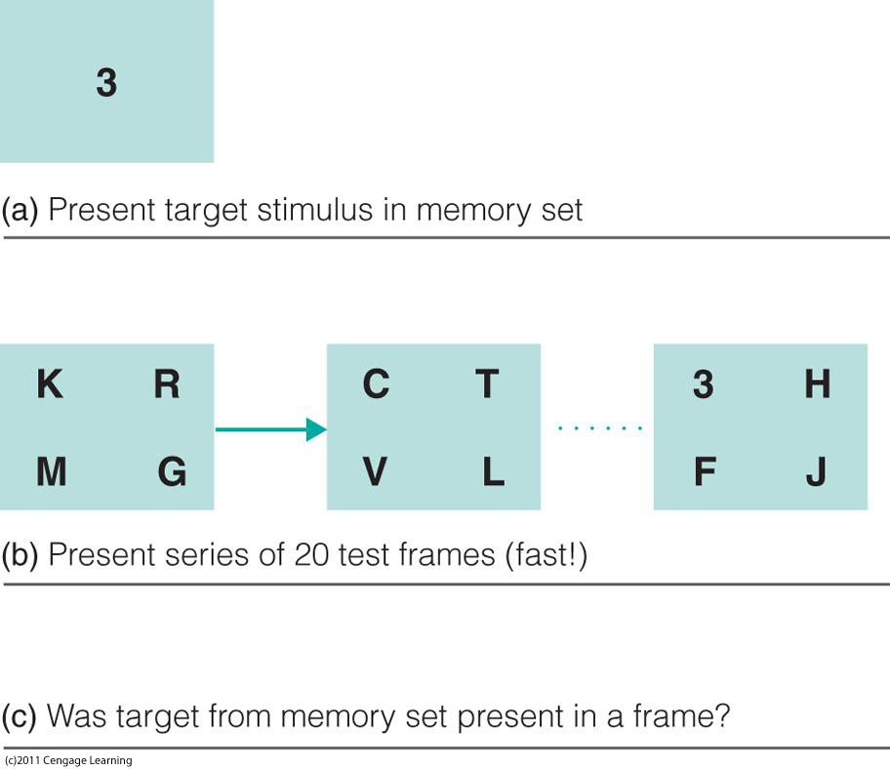
Attention and Visual Search
Visual Search and Automaticity
Target memory set
RSVP procedure (Rapid Serial Visual Presentation)
Task: Target Present or Target Absent?
Schneider & Shiffrin (1977)
Notes:
Automaticity was extensively explored by Schneider & Shiffrin. To do so, they used a visual search task using an RSVP procedure. RSVP stands for Rapid Serial Visual Presentation. Accordingly, a series of displays were presented sequentially and briefly, say for 25 ms. Each. On each display was one or more letter and number. Prior to the RSVP, subjects were given a target memory set of several letters or numbers. In this case, the target memory set is 4,7,3, and 5. The subject’s task was to respond target present if one of the targets appeared in the RSVP stream or target absent if they did not.

Slide 4
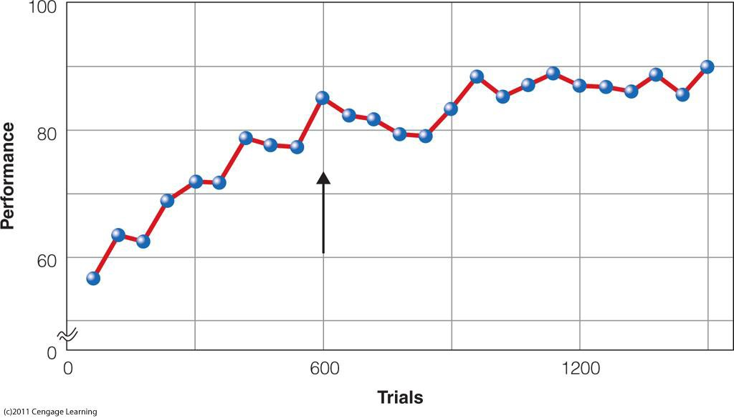
Visual Search Training
Visual Search and Automaticity
Target memory set
RSVP procedure (Rapid Serial Visual Presentation)
Task: Target Present or Target Absent?
Schneider & Shiffrin (1977)
After 600 or so trials, subjects reported that the task became automatic and performance no longer increased.
Should we trust introspections?
Notes:
The subjects performed this task many, many times, and performance increased over the first 600 or so trials, after which performance leveled off. Subjects reported that the task became automatic.
Should we trust introspections? Probably not…at least Schneider and Shiffrin did not.

Slide 5
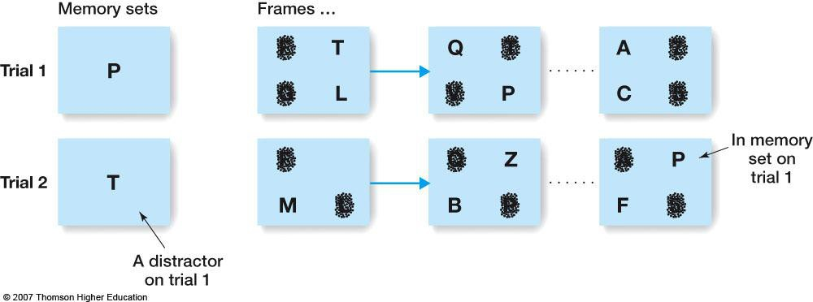
Visual Search Task
Visual Search and Automaticity
Target memory set varied mapping versus consistent mapping
RSVP procedure
Task: Target Present or Target Absent?
Schneider & Shiffrin (1977)
Subjects in the varied mapping condition did not improve very much and they never reported that the task became automatic.
Notes:
They conducted several other experiments that were almost identical to one that we just discussed. The only difference was that the target memory set had either varied a mapping versus a consistent mapping. In the consistent mapping condition, the target memory set was the same throughout the experiment. In the varied mapping condition, the target memory set changed periodically, such that the target on one trial may have been a foil or distractor on a prior trial.
Subjects in the varied mapping condition did not improve very much and they never reported that the task became automatic.

Slide 6
Target Set and Visual Search
Visual Search and Automaticity
Target memory set varied mapping versus consistent mapping
RSVP procedure
Task: Target Present or Target Absent?
Vary the search set size from 1 to 4 to increase load.
Schneider & Shiffrin (1977)
Search Set = 2
If the task is performed automatically, then increasing the load to should not affect performance.
Notes:
Schneider and Shiffrin reasoned that if the task is performed automatically in the consistent mapping condition, then increasing the load should not affect performance. They varied the load by varying the number of stimuli on each display. This was referred to as the search set size. Here the search set size is two, but it varied from 1 to 4.
If the visual search is automatic, then increasing the number of stimuli should not negatively affect performance. In these experiment the dependent variable was reaction time, and thus it should not change with increases in the search set size.
If, on the other hand, the visual search is not automatic, then increasing the number of stimuli should harm performance. That is, reaction time should increase with increase in the search set size. Specifically, the rate of increase in the target present condition should be half the rate of increase in the target absent condition. This is because on average only half of the stimuli on a display need to be searched in order to find a target, but all the stimuli need to be searcher in order to determine that a target is not there.

Slide 7
Visual Search Slopes
Performance after about 600 Trials
Absent
Present
Visual Search and Automaticity
Target memory set varied mapping versus consistent mapping
RSVP procedure
Task: Target Present or Target Absent?
Vary the search set size from 1 to 4 to increase load.
Varied
Mapping
Reaction Time
Why 2:1 slope ratio?
1 2 4
Performance after about 600 Trials
If the task is performed automatically, then increasing the load to should not affect performance.
Notes:
These are the results of the varied mapping condition. As you can see, it appears that visual search did not become automatic. The reactions times in both the target present and the target absent conditions increased with search set size, and the slope of the target present function was one half the slope of the target absent function.

Slide 8
Automaticity and Search Slopes
Performance after about 600 Trials
Visual Search and Automaticity
Target memory set varied mapping versus consistent mapping
RSVP procedure
Task: Target Present or Target Absent?
Vary the search set size from 1 to 4 to increase load.
Consistent Mapping
Reaction Time
Absent
Present
Search Set Size
1 2 4
If the task is performed automatically, then increasing the load to should not affect performance.
Notes:
These are the results of the varied mapping condition. As you can see, it appears that visual search did not become automatic. The reactions times in both the target present and the target absent conditions increased with search set size, and the slope of the target present function was one half the slope of the target absent function.

Slide 9
Study Guide 1
True or False? From the perspective of Schneider and Shiffrin, driving a car is like riding a bicycle.
True
False

Slide 10
Study Guide 1
True or False? From the perspective of Schneider and Shiffrin, driving a car is like riding a bicycle.
True
False

Slide 11
Study Guide 2
True or False? RSVP stands for rapid serial visual presentation.
True
False

Slide 12
Study Guide 2
True or False? RSVP stands for rapid serial visual presentation.
True
False

Slide 13
Study Guide 3
True or False? In Schneider and Shiffrin's experiment the subjects introspections were wrong as usual.
True
False

Slide 14
Study Guide 3
True or False? In Schneider and Shiffrin's experiment the subjects introspections were wrong as usual.
True
False

Slide 15
Study Guide 4
True or False? Task performance evolves with practice from requiring attention to being automatic as long as the task demands do not change.
True
False

Slide 16
Study Guide 4
True or False? Task performance evolves with practice from requiring attention to being automatic as long as the task demands do not change.
True
False

Slide 17
Study Guide 5
True or False? When search set size increases in a visual search task, a decrease in RTs indicates that performance has become automatic.
True
False

Slide 18
Study Guide 5
True or False? When search set size increases in a visual search task, a decrease in RTs indicates that performance has become automatic.
True
False

